Slide 1
PEP 4/22/2020
Dairy and Livestock Programs

Slide 2
General Resources:
AgCentric website –
  https://agcentric.org/what-we-do/covid-19-resources-for-educators/
SBA -
  https://www.sba.gov/
Farm Bureau
  https://www.fb.org/
Minnesota Milk
  CORE program (COronavirus REcovery) – proposed $9/cwt x March milk production
  https://www.mnmilk.org/dairy-core-program/
National Milk Producers Federation
  Workforce documents - https://www.nmpf.org/coronavirus/

Slide 3
Existing Programs

Slide 4
DMC - Overview
Dairy Margin Coverage – offered through FSA
Enrollment is voluntary
Producers selected a coverage level between $4.00 and $9.50 and coverage percentage from 5% to 95%
Based on highest of 2011, 2012, 2013 milk production
Tier 1 <5 Million pounds of milk
  $9.50 premium is $0.15/CWT without credits $0.114 with
Tier 2 >5 Million pounds of milk
  Premiums much higher

Slide 5

DMC - signup
2020 signup closed Dec 13, 2019
Will it be re-opened?
New producers can still sign up
  60 days after start-up
  Transitions?
    Not a part of previous operation

Slide 6
DMC Tracking – dairymarkets.org
https://dairymarkets.org/
https://www.fsa.usda.gov/programs-and-services/dairy-margin-coverage-program/index

Slide 7
Dairy – RP insurance
Sold through crop insurance agents
Pricing options for Class 3, Class 4, or Components
Subsidized from 44% to 59%
Backed by RMA
Can be used with DMC
No milk production limits
Can be purchased any business day except holidays and 3 Dairy reports per month
Daily quotes – sign up for emails or text messages
Sold on a Quarter basis – can buy coverage for 5 quarters
Similar to a Put option on CME
  Producers lock in a floor but have all the upside potential
Indemnities would be paid/premium due after end of the Qtr

Slide 8
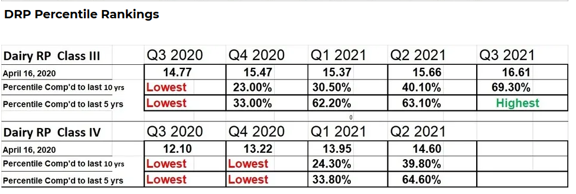
Dairy – RP

Slide 9
Dairy – RP What the Producer needs
How many pounds of milk produced per month
COP
Average basis
How many pounds of milk they want to protect
Sold by the Quarter
Protection factor
https://quote.dairygrossmargin.com/

Slide 10
Dairy - RP
Example:
  http://www.dairygrossmargin.com/
  Dairy RP Excel Sheet
  Q2 2020
    Purchased insurance April – Oct 2019
  9,000 CWT/Month
  0% Actual Production change
  95% coverage
  Average price $17.26
  Premium cost $0.27
  1.25 PF

Slide 11
Dairy – RP
The actual ending milk or component values are based upon the monthly average prices announced by USDA’s Agricultural Marketing Service.
Actual ending values are posted on RMA’s website at the end of the insurance period. The milk yields are based upon USDA’s National Agricultural Statistics Service Milk Production report.

Slide 12
LGM – Livestock Gross Margin
Provides protection against loss of gross margin (market value of livestock minus feed costs)
Eligible Species
  Swine
  Cattle Finishing
  Dairy
Example for Cattle Finishing:
  (12.50 * Live Cattle price) – (7.50 * Feeder Cattle price) – (50bu * Corn price)

Slide 13
LRP – Livestock Risk Protection Program
Provides protection against price declines
Eligible Livestock
  Swine (200-300 pound live weight)
  Fed Cattle (1000-1400 live weight)
  Feeder Cattle (up to 900 pounds)
  Lamb (50-150 pound live weight)
Coverage determined by # of head and target weight
Does not include margin or feed costs

Slide 14
COVID/New Programs

Slide 15
COVID Specific Small Business Resources
Families First Act
  Requires employers to offer paid sick leave for COVID-19
  < 500 workers – IRS tax credit. May be able to retain payroll taxes
CARES Act
  PPP
    Another $150B proposed?
    SBA will be coming out with a loan forgiveness calculator soon

Slide 16
CFAP? (Coronavirus Food Assistance Program)
Few details yet…
$16B to producers
  $5.1 B to cattle producers
  $2.9 B to dairy
    Estimated payment between $1.50 and $1.75/CWT
    About $300/head
    Max payment projected at > 400 cows
  Cap at $125,000 per commodity and $250,000 per entity

Slide 17
Dumping Milk
We are not sure what programs or DRP may need for documentation
FSA is advising farms verify production if asked to dump milk
  Picture of the bulk tank dipstick with date stamp
  Picture when the valve is opened with date stamp
  Write down the date and weight
  Take a milk sample and test for components
  Best to get 3rd party verification

Slide 18
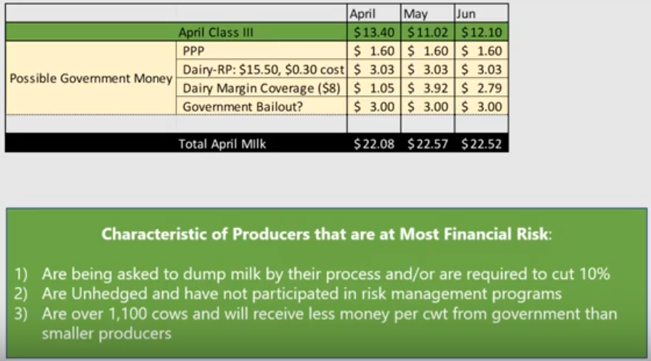
Thinking about At-Risk Farms – Matt Gould

