Slide 1
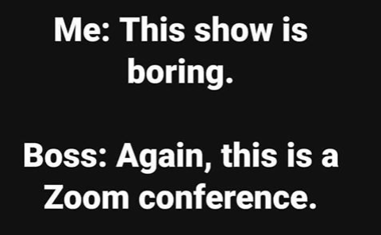

Slide 2
Remember to Record!

Slide 3
Coronavirus Updates
Farm Business Management
Recorded April 22, 2020

Slide 4
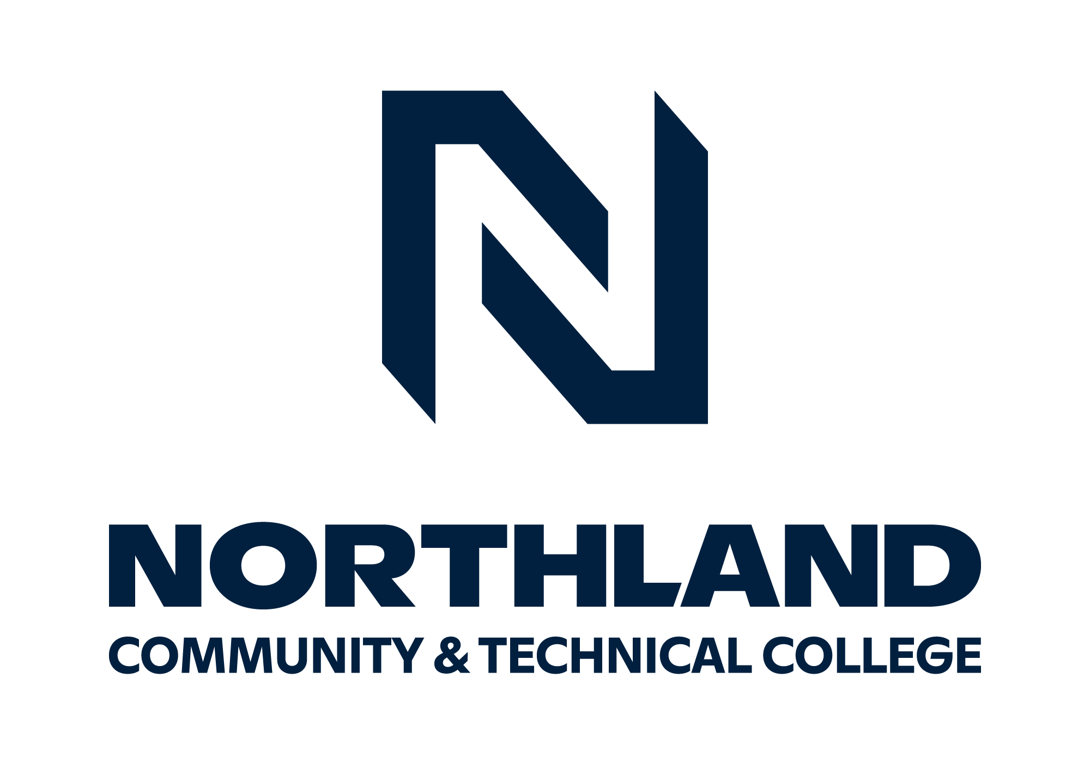
Minnesota Farm Business Management 68 Instructors at 8 Colleges

Slide 5
CCC Loans

Slide 6
Mediation Updates

Slide 7
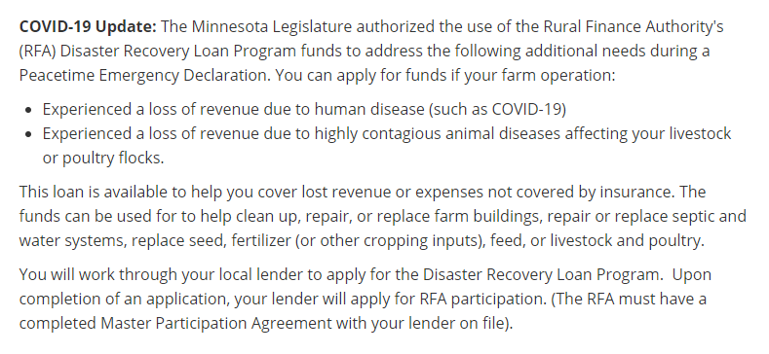
RFA

Slide 8
References for your Farmers
Agcentric.org
Umash.umn.edu
Mda.state.mn.us Covid19 Page

Slide 9
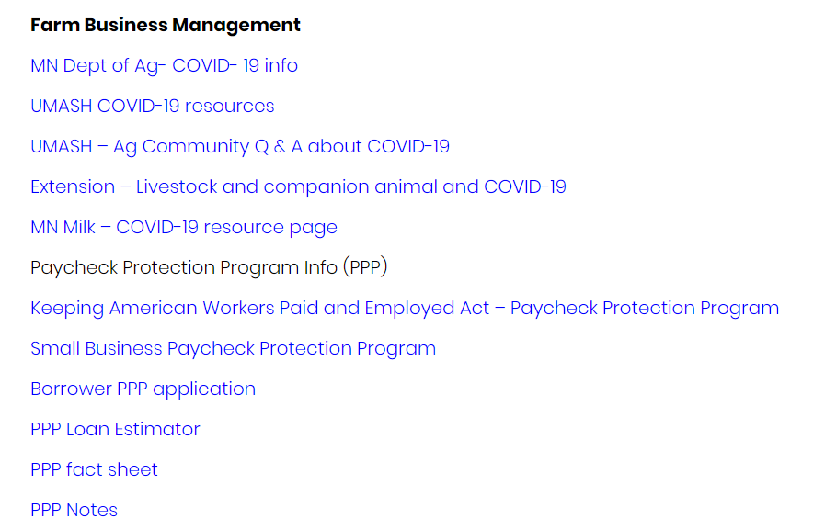

Slide 10
Umash.umn.edu

Slide 12
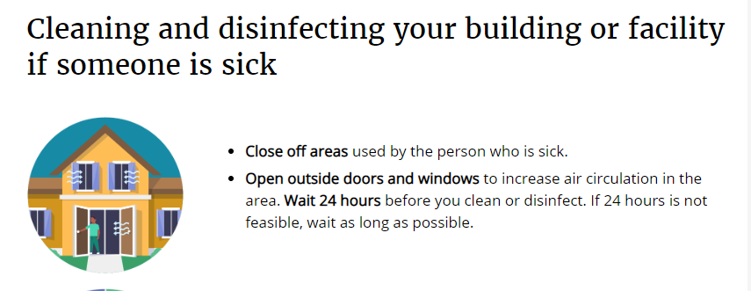

Slide 13
Betsy’s 3rd Party Risk Sermon
https://www.revisor.mn.gov/statutes/cite/223/full#stat.223.177.3
Selling grain and deferring the money, or not getting paid in a timely manner
Cash sale rules

Slide 15
More Grain Contracting

Slide 16
Grain Buyers Bond Pop Quiz
What is the maximum bond required for an elevator?
$50,000
$100,000
$500,000
$600,000
$1,000,000

Slide 17
Grain Buyers Bond Pop Quiz
What is the maximum bond required for an elevator?
$50,000
$100,000
$500,000
$600,000
$1,000,000
***New as of 2017, prior to this it may have been $150,000 or $500,000, depending on license****

Slide 18
Quote from General Manager…
growers need to be careful, especially with ethanol plants. One of our customers that sells his corn to Tharaldson has his entire 2019 crop on unpriced basis contracts there. Some of these plants will go bankrupt, so any growers that have unpaid grain at these plants need to get paid ASAP
Just to add- we have the state do a grain measurement annually, we also have an independent audit done by Widmer Roel CPA accounting firm annually, at which time they do another grain measurement and full financial audit. If you look at some of the coops that had fraudulent activity and went bankrupt the last few years, they had an accounting firm that wasn’t qualified and did no 3rd party audit or measurements. We go to a lot of lengths to ensure there are no mistakes anywhere.

Slide 19
MDA License Search
http://www2.mda.state.mn.us/webapp/lis/default.jsp
Grain and livestock buyers
“But it’s just paperwork, he’s a really good guy that just forgets things”
I don’t believe any grain or livestock buyers are intentionally crooked. But circumstances and bad practices lead them down a path from which they cannot recover

