Slide 1
An Introduction to Farm Financial Analysis Part 2: The Recordkeeping Habit or What is the next step?
North Carolina A&T Producer Meeting
September 24, 2020
Presented by: Bruce Fowler and DelRay Lecy
Notes:
Del

Slide 2
The Presenters…
Bruce Fowler
Missouri
DelRay Lecy (Del)
Minnesota
Notes:
Bruce

Slide 3
Please introduce yourself…in the chat box
If not a farmer, what do you do?
What is ONE question that you would like answered during our discussion today?
ALSO: Enter your email address in the chat box for future communications
Notes:
Bruce

Slide 4
In Review…
We talked about “Where to start…”
We presented many questions about your goals and information for your business…
We talked about the value of an extra $1,000 in your business or for your family…
We talked about the importance records and the habit of keeping them.
And, we reviewed several reports that provide information to help make decisions…
Including: Basic Financial Statement Example
Notes:
Del

Slide 5
In Review…
But…
We jumped the gun a little with that file
We did not show how to gather the data for that file…
We did not demonstrate a basic tool for tracking income and expenses using Excel
So, we need to do that during this workshop
Notes:
Bruce

Slide 6
So…What is in a good set of farm records?
Farm receipts and expenses (broken out as appropriate)
Crop information
Records of feed fed to animals
Animal acquisition and disappearance
Inventories of animals, crops and feed
Notes:
Bruce

Slide 7
So…What is in a good set of farm records?
Machinery, equipment, building and land inventories and depreciation
Non-farm assets, liabilities and income
Household and personal records
Labor records
You have to start somewhere…start with what is important to you for your operation
Notes:
Bruce

Slide 8
Records, Records, Records…I have heard it all before and it is just too hard to get done…
Farming isn’t easy in the first place and making decisions based on what you “think” is never as good as making decisions based on what you “know”.
…records help you know more.
Knowing builds confidence and profit
Notes:
Del and Bruce

Slide 9
Remember this about good farm records…
First, you must realize that keeping records is a habit that is critical to long term business success
Second, it is critical to keep records of the things you need to help make informed decisions
Third, you just have to decide to do it.
Notes:
Bruce

Slide 10
Also remember this example of a report you can use for decisions IF you have good records…
Vegetable Farm Analysis – This is what you are looking to have at the end of the year
Our goal is to show you a step towards creating an analysis of your operation…
Notes:
Bruce

Slide 11
Lets take a look as a basic record keeping tool in Excel…
Our focus tonight is on recording Income and Expense
A key factor in recording income and expense to do it on a timely, regular basis (NOTE: annually is not timely or regular)
Daily tracking and filing of income and expense is necessary
Recording that information into a record keeping system should be done at least monthly
Notes:
Del

Slide 12
Lets take a look as a basic record keeping system in Excel…
Here is a basic Excel record keeping worksheet.
Notes:
Del

Slide 13
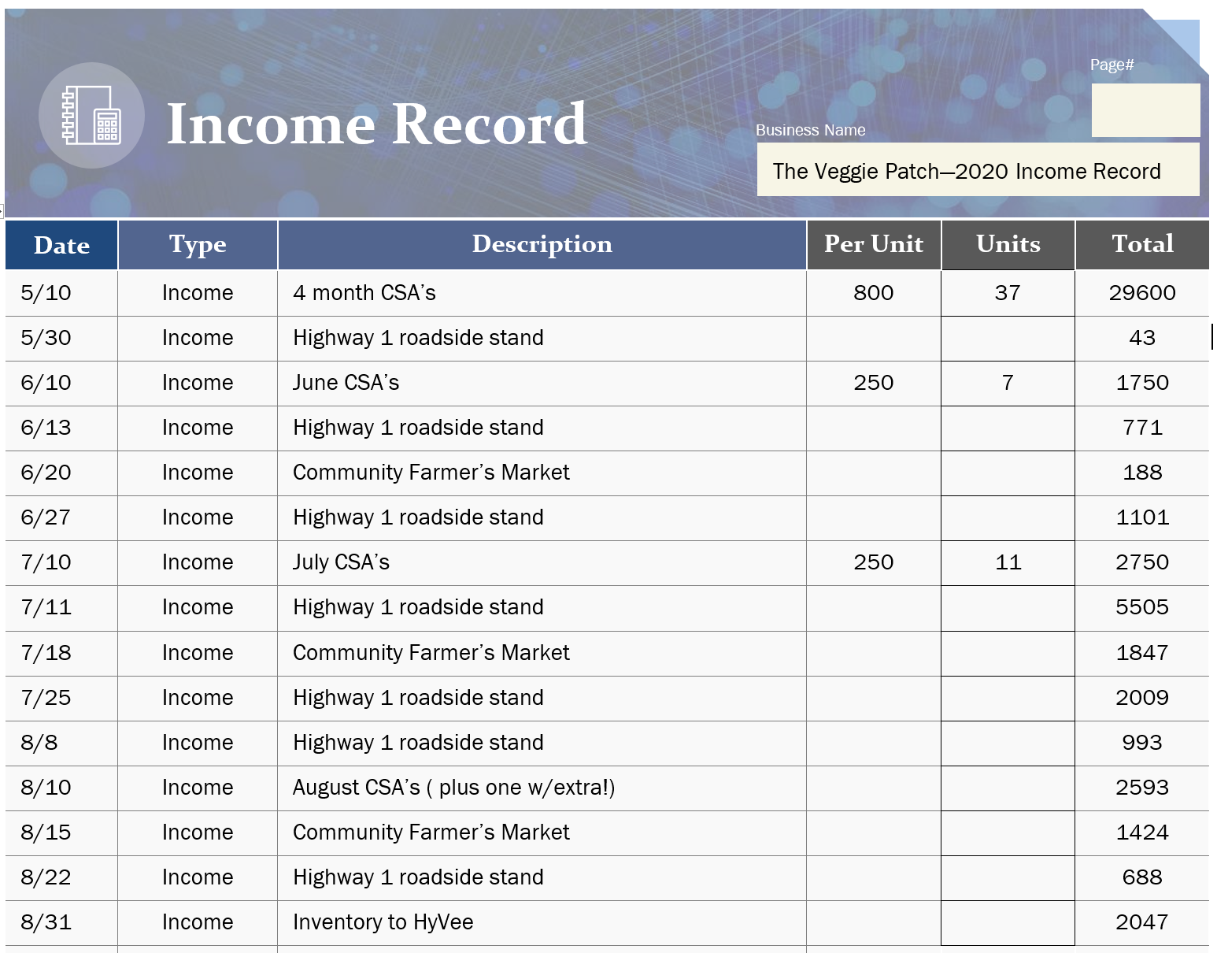
SAMPLE Crop Income Items for us to review…
Notes:
Bruce –
Enter May-June and then open for questions
Time permitting, complete July-August and then open for questions again
Time not permitting – encourage them to complete July-Aug on their own
Then jump to expenses…

Slide 14
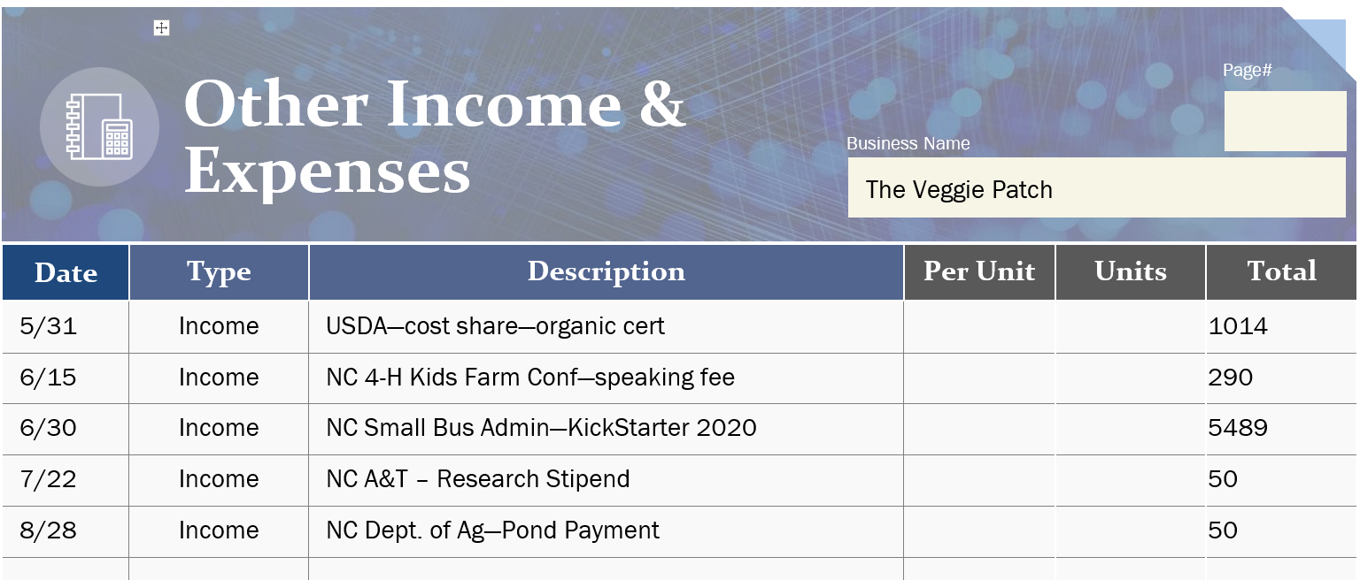
SAMPLE Other Income Items for us to review…
Notes:
Bruce

Slide 15
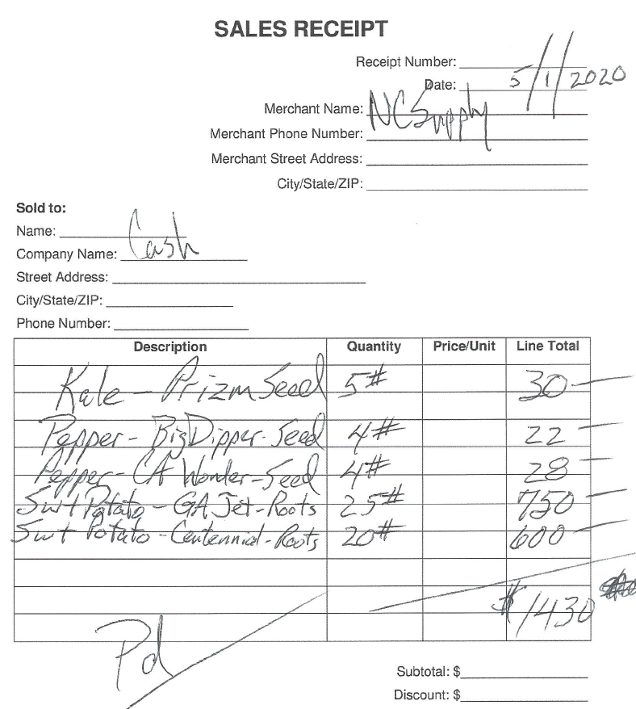
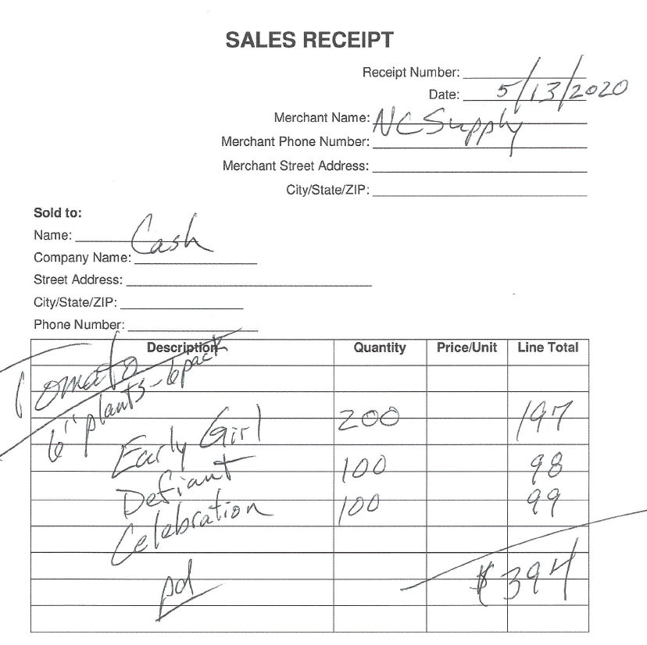
SAMPLE Expense receipts for us to review…
Purchased from:
NC Supply Company
Notes:
Bruce
Initially – enter them in group for a whole farm summary
When you want to analyze each crop (enterprise), you need to separate

Slide 16
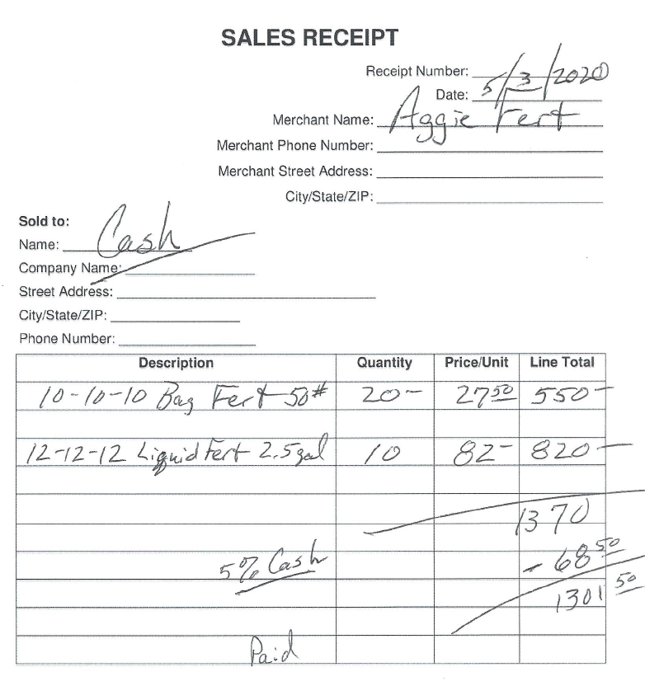
SAMPLE Expense receipts for us to review…
Purchased from:
Aggie Fertilizer Company

Slide 17
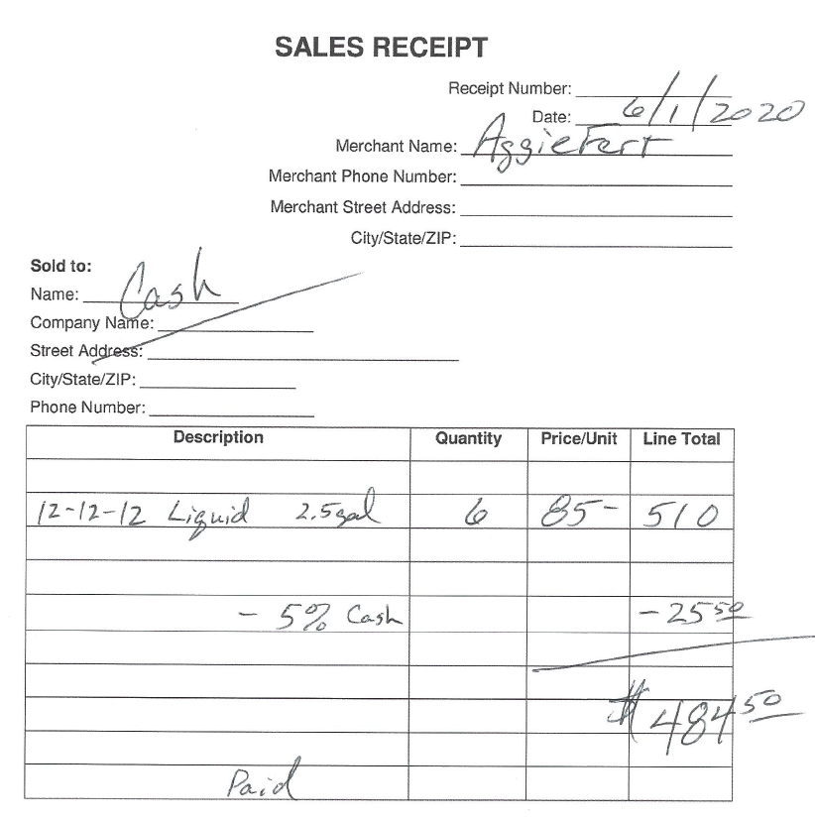
SAMPLE Expense receipts for us to review…
Purchased from:
Aggie Fertilizer Company

Slide 18
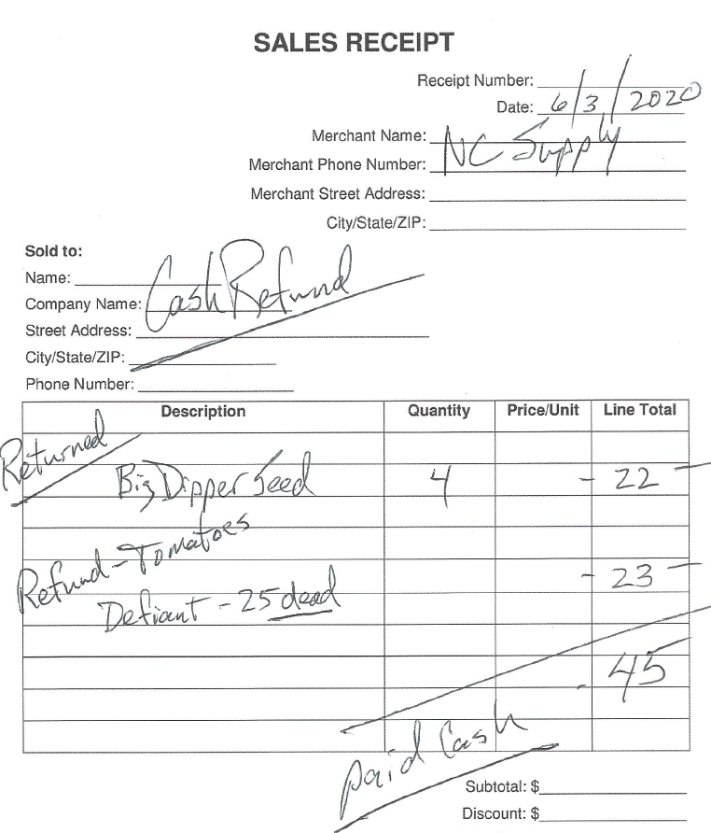
SAMPLE Expense receipts for us to review…
Refund from:
NC Supply Company

Slide 19
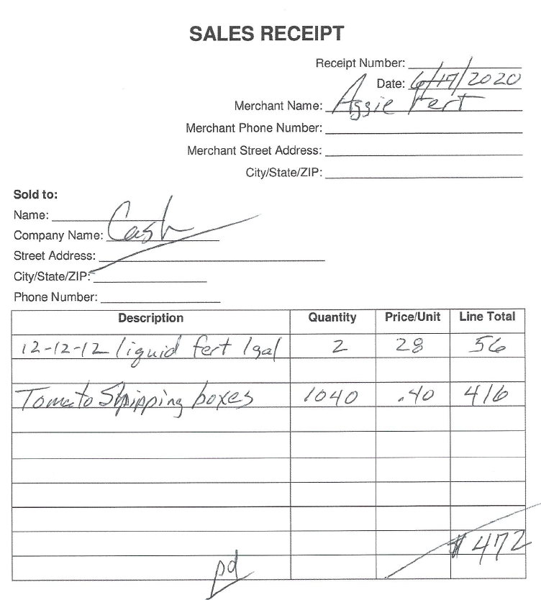
SAMPLE Expense receipts for us to review…
Purchased from:
Aggie Fertilizer Company

Slide 20
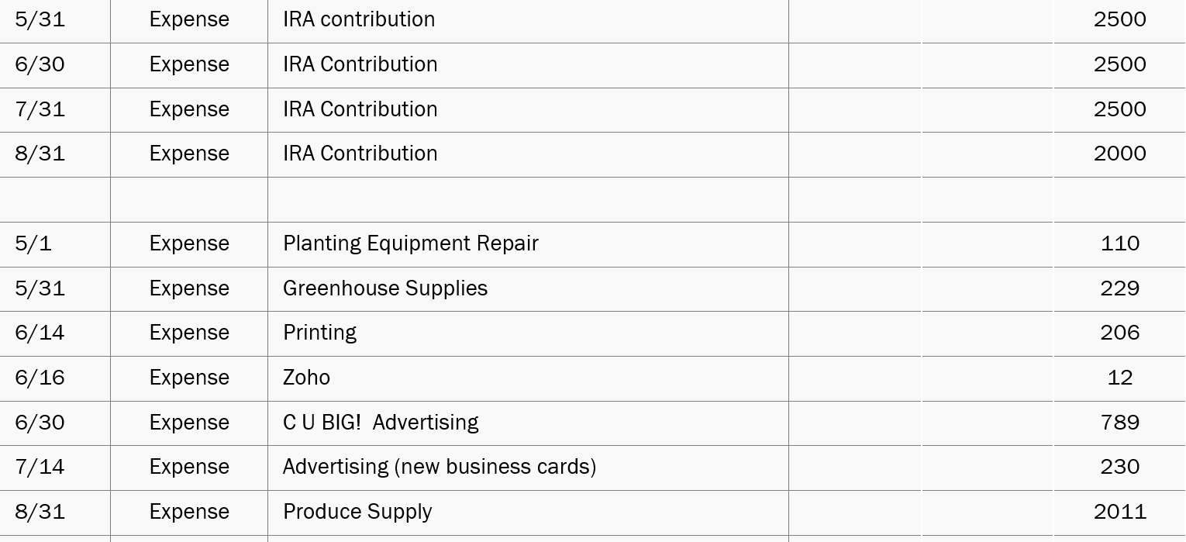
SAMPLE Other Expense Items for us to review…

Slide 21
So…what does the printout look like for this tool
Basic Recordkeeping Tool Printout
Notes:
Del

Slide 22
One step at a time…
You now have your income and expense summary for the year
Once you have that information, you are ready for thinking about a whole farm financial analysis
As another step, lets take a brief look at that “Financial Statement” file once again… Basic Financial Statement Example
That step is for future discussions…
Notes:
Del…
Notice the order of the worksheets listed along the bottom…
The first one is the Balance Sheet
As stated before, the starting point for a business analysis is the Balance Sheet…what do you own and owe at the beginning of your business year?
This sets us up for the next workshop…

Slide 23
We hope that you have found value in this presentation…
In Conclusion…
Do we have any questions in the chat box?
Notes:
Del

Slide 24
In Conclusion…
Please answer the two questions below using the chat box…
What change are you going to make because of this presentation?
What question do you have that was not answered today?
Notes:
Del

Slide 25
Thank you for participating today

