Slide 1
2022 Crop Year in Review
April 2023
Minnesota State Farm Business Management
Analysis Trend Data for Crops
Compiled by Aaron Brudelie / Jeremy Daberkow
Minnesota West Community and Technical College Farm Business Management Instructors

Slide 2
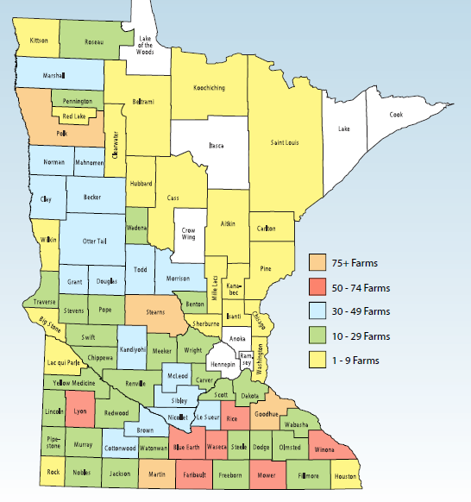
2022 Farm Business Management Financial Analysis by County
The 2,154 producers who provided data for three MN regional reports are located in 79 of Minnesota’s 87 counties. Those counties are highlighted on the map to the left, color coded based on the number of farms included from each county.

Slide 3
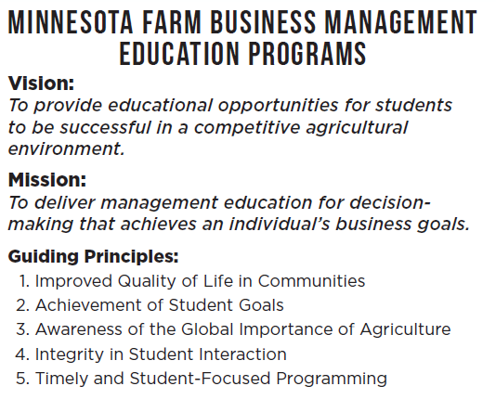
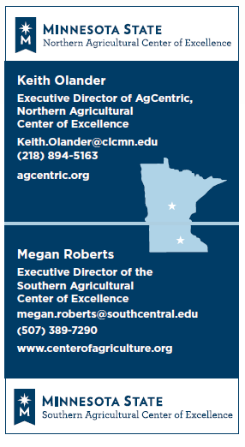

Slide 4

www.minnesotafarmstress.com (MDA)
There are people and organizations ready to help. Explore them here:
Help with Stress, Anxiety, Depression, Feeling Stuck, and Crisis Situations
Help with Daily Living
Business, Financial and Legal Help
If you need help figuring out who to contact, call us at 833-600-2670 x0 during business hours, or use TTY at 711.

Slide 5

Mental Health Outreach Program
There are people and organizations ready to help. Explore them here:
Assist in Meeting Farm Business and Personal Goals
Direct Effective Financial Management
Support Rural Mental Health
Guide Sound Business Decisions
Advise Farm Transition and Succession Planning
Develop Farm Efficiency
Increase Access to Lending Opportunities

Slide 6


Slide 7
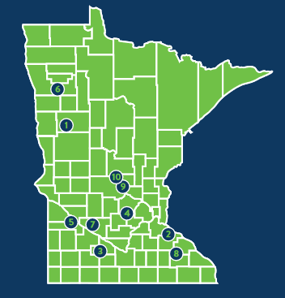
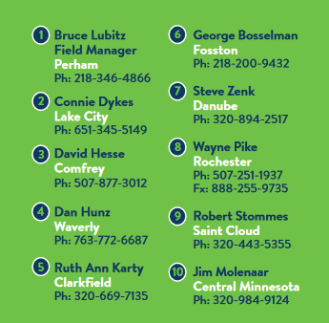
Minnesota Farm Advocate Program
There are people and organizations ready to help. Explore them here:
Since 1984
Peer farmers
Natural or financial disaster
In the farmer’s corner
Help navigate solutions to difficult and complex problems
  Lending/lender negotiation, mediation, farm programs, crisis counseling, disaster programs, legal and/or social services

Slide 8
Minnesota Farm-Lender Mediation
Mediation uses a neutral facilitator to help resolve disputes:
Offers farmers the chance to renegotiate, restructure, or resolve farm debt
No cost
Informal, confidential process
Debtor has 14 days to respond and file mediation request after getting notice from a creditor
Call 218-935-5785

Slide 9

Farmers’ Legal Action Group (FLAG)
There are people and organizations ready to help. Explore them here:
Nonprofit law center
Roots in the 1980’s farm crisis
Legal services and support for family farmers and their communities to help keep family farmers on the land
Call 651-223-5400

Slide 10

Corn Production

Slide 11
Corn Yields per Acre

Slide 12
Total Listed Costs per Acre for Cash Rented Corn

Slide 13
Corn Returns per Acre (before labor & mgmt)

Slide 14
Total Listed Costs for Corn/bu. (before labor & mgmt)

Slide 15
Average Price of Corn Sold During Calendar Year

Slide 16
Seed Cost per Acre for Corn

Slide 17
Fertilizer Costs per Acre for Corn

Slide 18
Chemical Costs per Acre for Corn

Slide 19
Row Width vs. Yield for Corn from Statewide Database

Slide 20
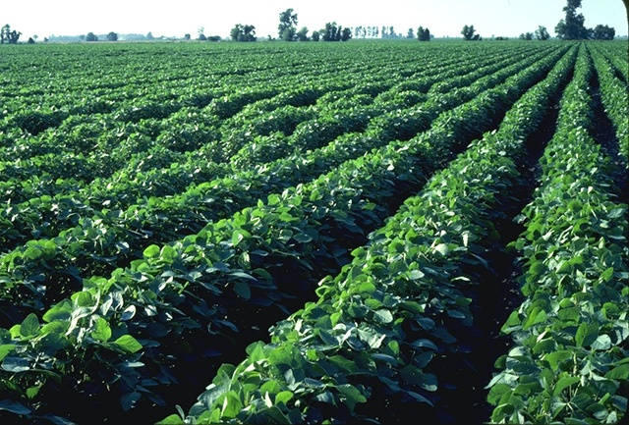
Soybean Production

Slide 21
Soybean Yields per Acre

Slide 22
Soybean Returns per Acre (before labor & mgmt)

Slide 23
Total Listed Costs per bu. Soybeans (before labor & mgmt)

Slide 24
Seed Costs per Acre of Soybeans

Slide 25
Chemical Costs per Acre of Soybeans

Slide 26
Average Price of Sold Soybeans During Calendar Year

Slide 27
Soybean Yield vs. Row Width from Statewide Database

Slide 28

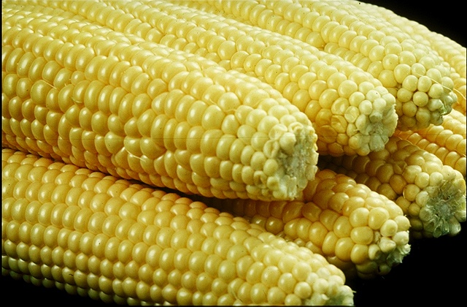
Vegetable Crops

Slide 29
Pea Yield on Cash Rented Land

Slide 30
Pea Returns on Cash Rented Land (before labor & mgmt)

Slide 31
Sweet Corn Yield on Cash Rented Land

Slide 32
Sweet Corn Returns per Acre on Cash Rented Land (before labor & mgmt)

Slide 33
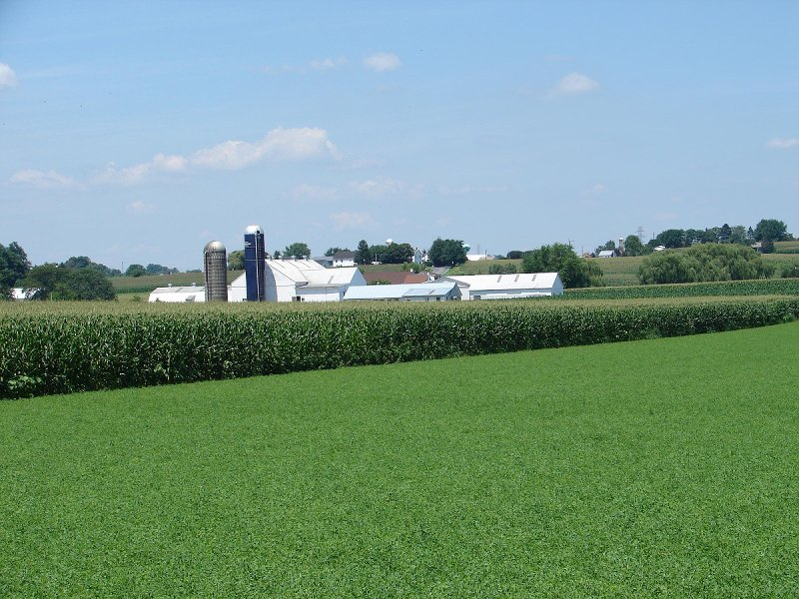
Alfalfa Hay Production

Slide 34
Alfalfa Yield per Acre

Slide 35
Alfalfa Return per Acre (before labor & mgmt)

Slide 38
Have a great year in 2023!

