Slide 1
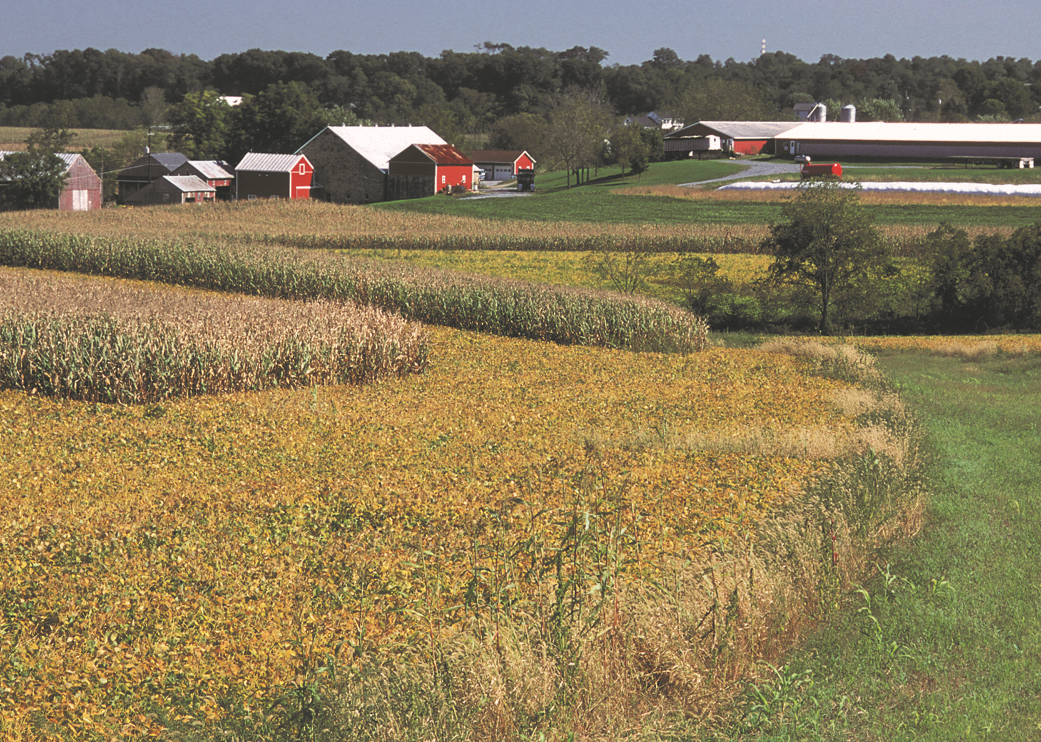
Crop Enterprise Information

Slide 2
Average Actual Sales
Price for Various Crops
Pg 27

Slide 3
Average Actual Sales
Price & Assigned Value (Rented land)

Slide 4
Average Value per Unit…
Crop Enterprise tables (Cash Rent)
Northern Minnesota

Slide 5
Net Return for Various Crops (Cash Rented)
Northern Minnesota

Slide 6
Machinery Cost per Acre
Pg 28
Machinery Cost includes: Fuel & Oil, Custom Hire, Mach. Leases, Interest on Mach. debt, and Mach. Depreciation.
Northern Minnesota

Slide 7
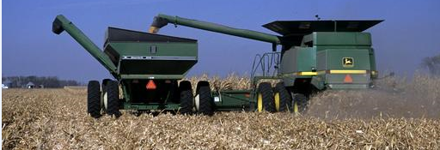
Corn (owned)
Pg 30
Net Return/Acre = $319.63
Northern Minnesota

Slide 8
Corn – Cost of Prod. Direct & Overhead (owned)
Pg 30
Northern Minnesota

Slide 9
Corn Yields & Net Return per Acre (owned)
Pg 30
Owned Acres Yield Net Return
2013 109 bu. $-44.10
2014 119 bu. $-75.40
2015 164 bu. $ -0.05
2016 180 bu. $1.65
2017 165 bu. $-14.68
2018 179 bu. $38.76
2019 160 bu. $35.63
2020 176 bu. $158.49
2021 141 bu. $233.93
2022 169 bu. $319.63
Northern Minnesota

Slide 10
2-year Corn Data
Pg 30-31
Rented Owned
 | 2021 | 2022 | 2021 | 2022
Yield per Acre | 124.58 | 169.41 | 141.10 | 168.99
Value per Unit | $5.30 | $6.06 | $5.30 | $6.09
Gross Revenue/Acre | 760.77 | 1,039.01 | 818.42 | 1,044.68
Dir & Ovhd Expense/Acre | 595.92 | 779.41 | 584.48 | 725.05
Net Return/Acre | 164.85 | 259.60 | 233.93 | 319.63
Dir & Ovhd Expense/Unit | $4.78 | $4.60 | $4.14 | $4.29
Northern Minnesota

Slide 11
Corn Inputs – the past 10 years
Pg 31
Northern Minnesota

Slide 12
Costs of Production per Bushel for Corn (Cash Rent)
Pg 31
Northern Minnesota
Notes:
NOTE: Used for BRIEF OVERVIEW – not necessarily for consideration with the Datashow.

Slide 13
Soybeans (owned)
Pg 32
Net Return/Acre = $190.43
Northern Minnesota

Slide 14
Soybeans–Cost of Prod. Direct & Overhead (owned)
Pg 32
Northern Minnesota

Slide 15
2-year Soybean Data
Pg 32-33
Rented Owned
 | 2021 | 2022 | 2021 | 2022
Yield per Acre | 30.4 | 39.9 | 30.6 | 39.7
Value per Unit | $12.21 | $13.89 | $12.25 | $13.93
Gross Revenue/Acre | 433.62 | 571.32 | 429.36 | 569.46
Dir & Ovhd Expense/Acre | 350.45 | 420.41 | 310.81 | 379.03
Net Return/Acre | 83.17 | 150.91 | 118.55 | 190.43
Dir & Ovhd Expense/Unit | $11.54 | $10.55 | $10.15 | $9.55
Northern Minnesota

Slide 16
Soybean Inputs – the past 10 years
Pg 33
Northern Minnesota

Slide 17
Corn Silage (owned)
Pg 36
Net Return/Acre = $190.28
Northern Minnesota

Slide 18
2-year Corn Silage Data
Pg 36-37
Rented Owned
 | 2021 | 2022 | 2021 | 2022
Yield per Acre | 14.3 | 19.4 | 13.3 | 19.4
Value per Unit | $42.25 | $48.24 | $41.87 | $45.33
Gross Revenue/Acre | 793.29 | 937.77 | 731.79 | 880.50
Dir & Ovhd Expense/Acre | 650.99 | 823.15 | 600.39 | 690.23
Net Return/Acre | 142.30 | 114.62 | 131.40 | 190.28
Dir & Ovhd Expense/Unit | $45.60 | $42.50 | $45.16 | $35.63
Northern Minnesota

Slide 19
Corn Silage Inputs – the past 10 years
Pg 37
Northern Minnesota

Slide 20
Corn Silage – Assigned value per Ton (cash rent)
Northern Minnesota

Slide 21
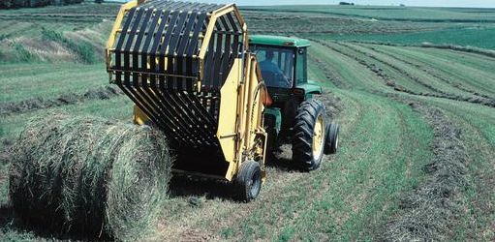
Alfalfa Hay (owned)
Pg 38
Net Return/Acre = $219.76
Northern Minnesota
Notes:
Yes, in 2012 and 2013, the YIELD and the Expense per Acre WAS THE SAME FOR ALFALFA

Slide 22
2-year Alfalfa Hay Data
Pg 38-39
Rented Owned
 | 2021 | 2022 | 2021 | 2022
Yield per Acre | 2.6 | 3.8 | 2.9 | 4.1
Value per Unit | $177.66 | $152.22 | $172.67 | $153.99
Gross Revenue/Acre | 478.30 | 577.02 | 520.80 | 633.43
Dir & Ovhd Expense/Acre | 351.98 | 415.74 | 384.31 | 413.66
Net Return/Acre | 126.32 | 161.27 | 136.48 | 219.76
Dir & Ovhd Expense/Unit | $133.78 | $110.28 | $131.01 | $101.02
Northern Minnesota

Slide 23
Alfalfa Hay Inputs – the past 10 years
Pg 39
Northern Minnesota
Notes:
Note that Fuel-Oil, Repairs, and Custom Hire total over 100 of the 127. See page 76

Slide 24
Spring Wheat (owned)
Pg 34
Net Return/Acre = $171.05
Northern Minnesota
Notes:
NOTE: 2013 include the whole region

Slide 25
2-year Spring Wheat Data
Pg 34-35
Rented Owned
 | 2021 | 2022 | 2021 | 2022
Yield per Acre | 49.5 | 64.9 | 50.3 | 64.4
Value per Unit | $8.55 | $9.18 | $8.80 | $9.05
Gross Revenue/Acre | 471.75 | 610.33 | 494.98 | 593.86
Dir & Ovhd Expense/Acre | 344.24 | 477.43 | 316.32 | 422.81
Net Return/Acre | 127.50 | 132.91 | 178.66 | 171.05
Dir & Ovhd Expense/Unit | $6.96 | $7.36 | $6.29 | $6.57
Northern Minnesota

Slide 26
Spring Wheat Inputs – the past 10 years
Pg 35
Northern Minnesota

Slide 27
Net Return for Various Crops (Irrigated)
Pg 43
Northern Minnesota

Slide 28
Cover Crop Slides

Slide 29
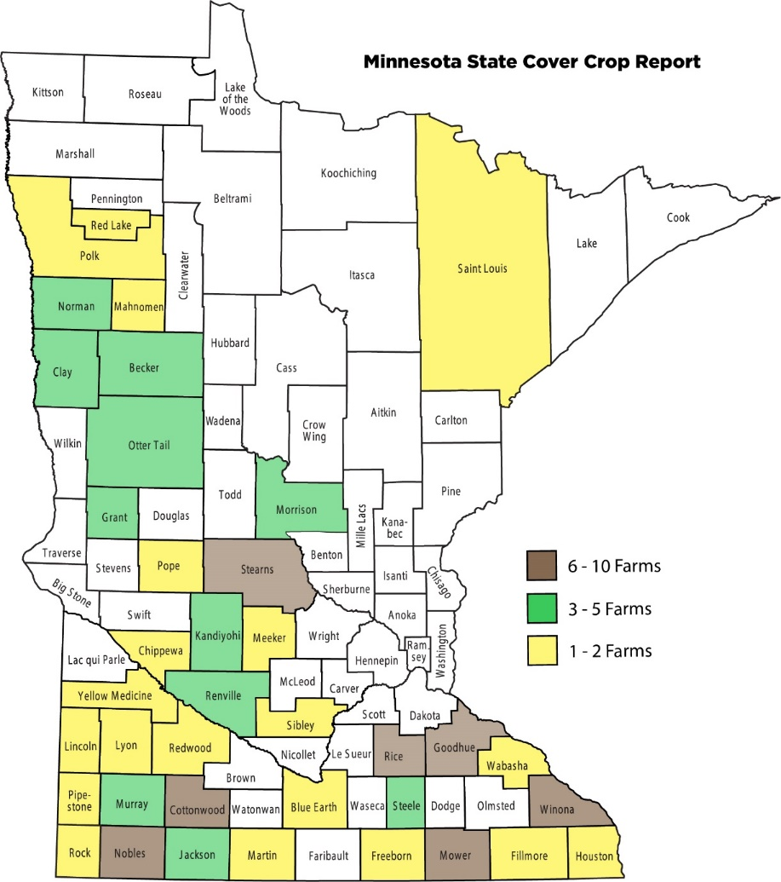
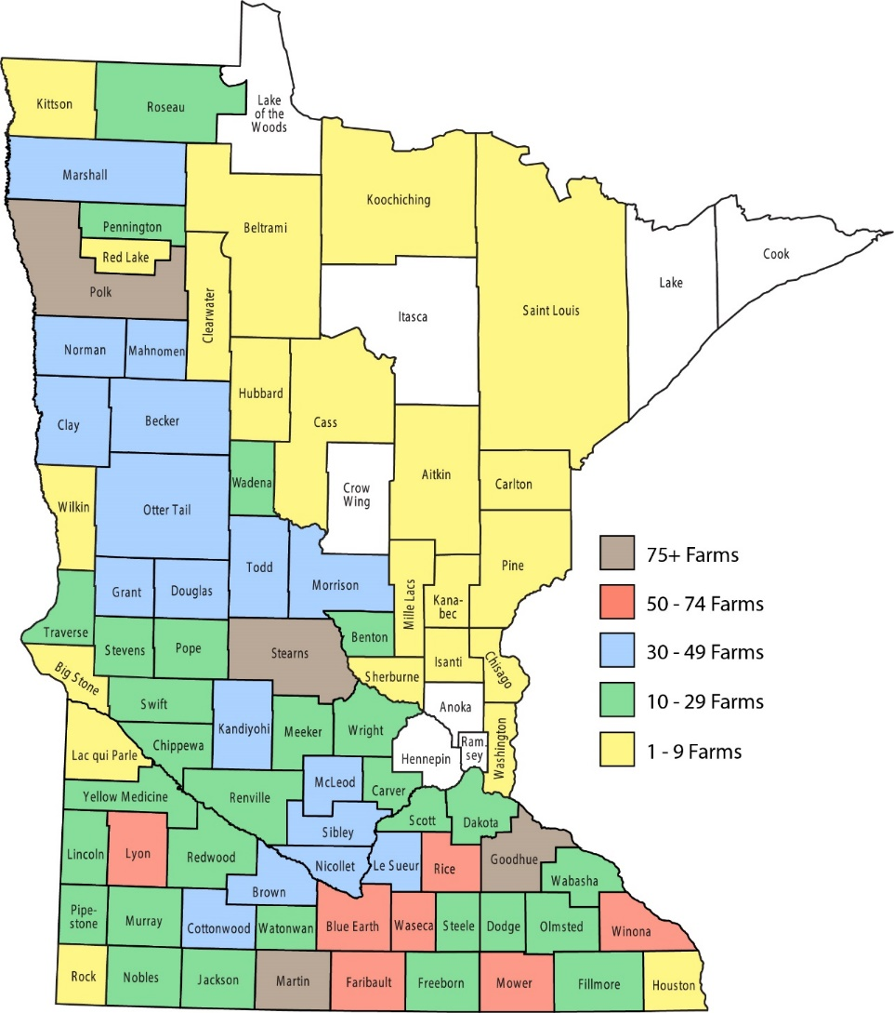
2022 Farm Business Management Financial Analysis by County

Slide 30
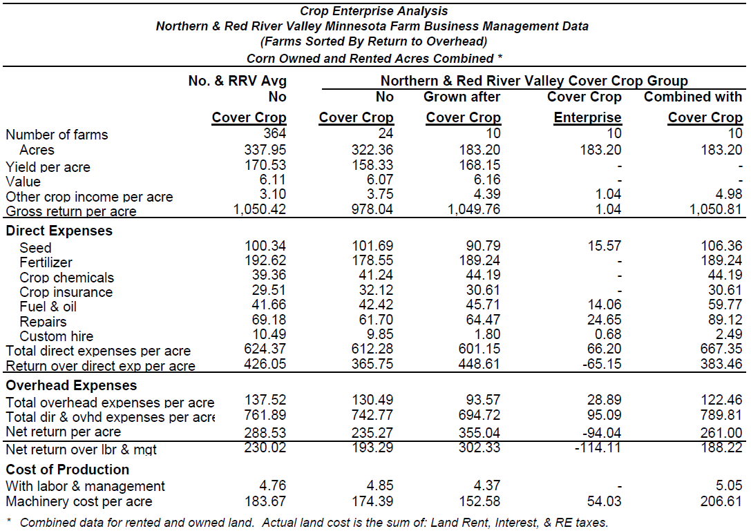

Slide 31
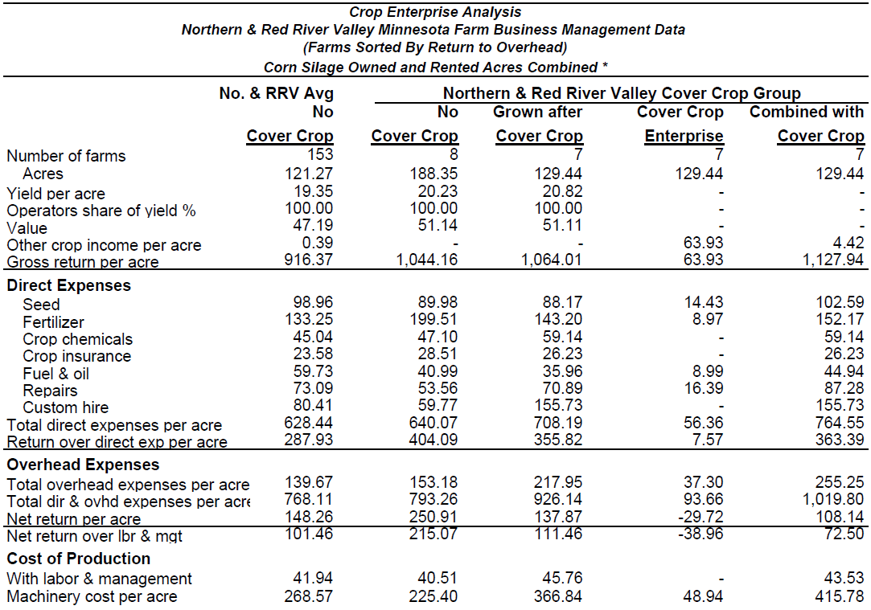

Slide 32
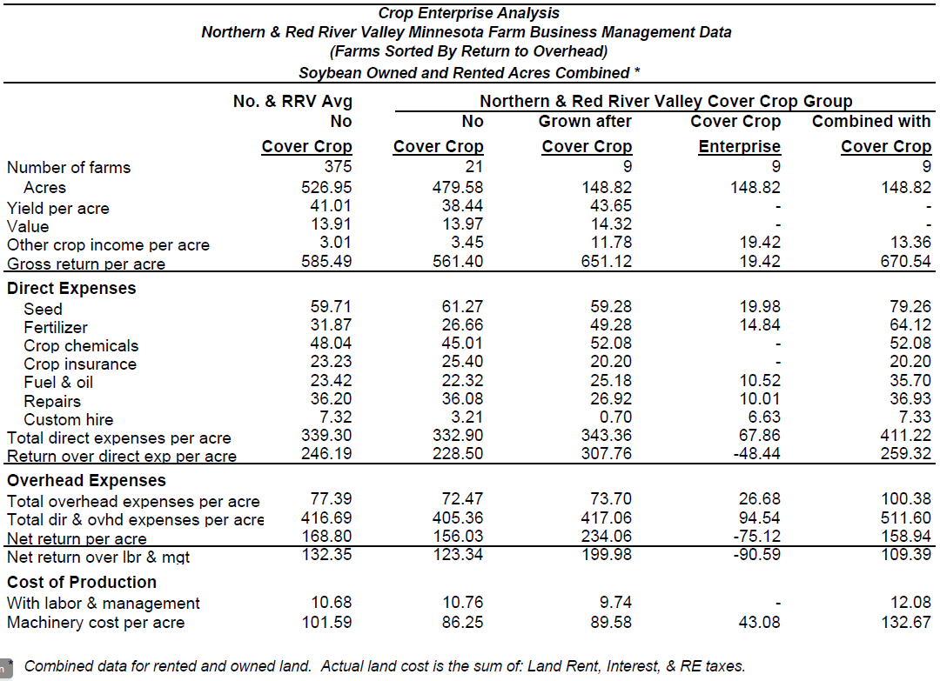

Slide 33
As you look to next year…
It is not the ONE BIG THING that must to be done well…to be successful over the long term…
It is doing a 100 LITTLE THINGS … better!

Slide 34
Current Efforts for resilience:
Rural Mental Health Specialists
* Supported in partnership with the Minnesota Department of Ag and Centers of Excellence
Ted Matthews
tedmatthews317@gmail.com
Cell Phone: 320-266-2390
*Monica McConkey Kramer
monicamariekm@yahoo.com
Phone: 218-280-7785

Slide 35
For more information…

Slide 36
Thank you for listening to a review of this year’s Farm Business Management Annual Report information.

