Slide 1
2022 Financial Year in Review
April 2023
Minnesota State Farm Business Management
Compiled by Aaron Brudelie, Minnesota West Community and Technical College Farm Business Management Instructor

Slide 2
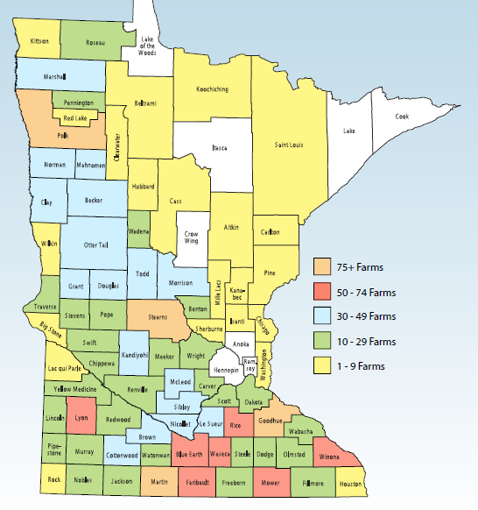
2022 Farm Business Management Financial Analysis by County
The 2,154 producers who provided data for three MN regional reports are located in 79 of Minnesota’s 87 counties. Those counties are highlighted on the map to the left, color coded based on the number of farms included from each county.

Slide 3
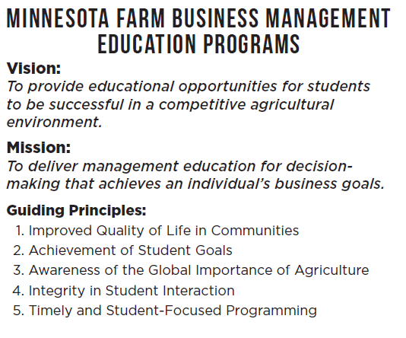
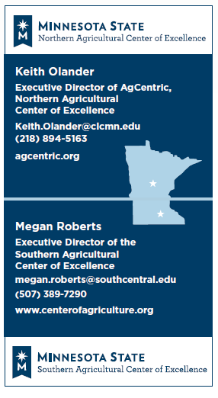

Slide 4
www.minnesotafarmstress.com (MDA)
There are people and organizations ready to help. Explore them here:
Help with Stress, Anxiety, Depression, Feeling Stuck, and Crisis Situations
Help with Daily Living
Business, Financial and Legal Help
If you need help figuring out who to contact, call us at 833-600-2670 x0 during business hours, or use TTY at 711.

Slide 5
Mental Health Outreach Program
There are people and organizations ready to help. Explore them here:
Assist in Meeting Farm Business and Personal Goals
Direct Effective Financial Management
Support Rural Mental Health
Guide Sound Business Decisions
Advise Farm Transition and Succession Planning
Develop Farm Efficiency
Increase Access to Lending Opportunities

Slide 7
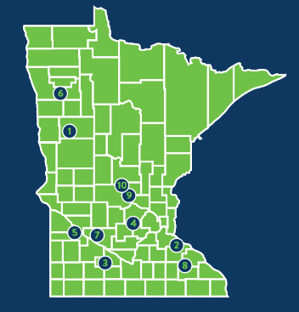
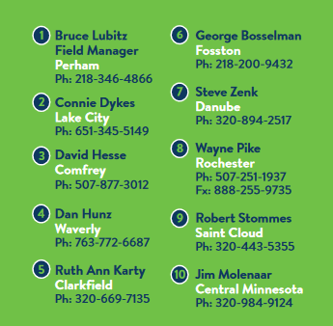
Minnesota Farm Advocate Program
There are people and organizations ready to help. Explore them here:
Since 1984
Peer farmers
Natural or financial disaster
In the farmer’s corner
Help navigate solutions to difficult and complex problems
Lending/lender negotiation, mediation, farm programs, crisis counseling, disaster programs, legal and/or social services

Slide 8
Minnesota Farm-Lender Mediation
Mediation uses a neutral facilitator to help resolve disputes:
Offers farmers the chance to renegotiate, restructure, or resolve farm debt
No cost
Informal, confidential process
Debtor has 14 days to respond and file mediation request after getting notice from a creditor
Call 218-935-5785

Slide 9
Farmers’ Legal Action Group (FLAG)
There are people and organizations ready to help. Explore them here:
Nonprofit law center
Roots in the 1980’s farm crisis
Legal services and support for family farmers and their communities to help keep family farmers on the land
Call 651-223-5400

Slide 10
Data from 1476 farms included in the South East, South Central, South West & West Central regions compiled in the Southern Minnesota report 18 Minnesota West Instructors 19 Riverland Instructors 13 South Central Instructors

Slide 11
2022 in Review
Gross farm income was, $1,077,094 in 2022, up from $967,436 in 2021 - up 11.3%
Cash operating expenses was, $884,679 in 2022, up from $ 790,104 in 2021 - up 11.9%
Net cash income was, $192,415 in 2022, up from $177,333 in 2021 - up 8.5%
Median net farm income was, $177,614 in 2021, up from $176,426 in 2021 - up .67%

Slide 12
2022 in Review
Corn production was up 4.6% to a yield of 212.7 bu., down from 203.3 bu. in 2021.
This is the highest yield was 215.3 in 2017. The lowest was 54 bu. in 1965.
Soybean production was down 1.6% to a yield of 59.7 bu., up from 60.7 bu. in 2020.
The lowest yield was 18 bu. in 1996. The highest yield was 61.3 bu. in 2016.

Slide 13
Farm Size Actual Number of Farms by Size

Slide 14
Age of Operator Actual Number of Farms by Operator Age Category
Total of 1476 Farms

Slide 15
Type of Farm Actual Number of Farms by Farm Type
Total of 1476 Farms

Slide 16
Gross Cash Farm Income & Total Cash Expenses

Slide 17
Net Cash Income

Slide 18
Net Cash Farm Income

Slide 19
Net Farm Income (Median)

Slide 20
Net Farm Income
Notes:
For an accurate picture, profit shouldn’t be measured in cash alone.
Net Farm Income consists of:
Net Cash Income
+/- change in current asset inventory
+/- depreciation & capital adjustments
+/- other adjustments for accounts payable, delinquent taxes and delinquent interest
Net Cash Income measures what’s in the checkbook, while Net Farm Income measures the business.

Slide 21
Net Worth Change (Cost)

Slide 22
Net Worth Change(Market)
Thousands

Slide 23
Year End Farm Assets

Slide 24
BALANCE SHEET ANALYSIS Total Assets: Equity -Vs- Debt (Cost Value)

Slide 25
Cash Flow Analysis Money Borrowed -vs- Debt Repaid (SCF)

Slide 26
Money Borrowed vs Principal Paid

Slide 27
Rate of Return on Farm Assets (ROA) Cost

Slide 28
Profitability Analysis Rate of Return on Assets at cost

Slide 29
Non-farm Income

Slide 30
Family Living Costs

Slide 31
Non-Farm Income & Family Living
Family living has stabilized over the past few years
In many cases, the employee benefits of off-farm employment adds significant value
Non-farm income pays for more than half of household and personal spending

Slide 32
Money Spent by the Average Farmer South of I-94 in Minnesota

Slide 33
Farm & Family Spending
In 2022, the average farm business spent a total of $1,281,210 for farm business operating, capital purchases and family living. Much of this was spent in the local community for supplies and inputs, labor, real estate taxes, interest, real estate purchase, and rent. Some of it left the community for the purchase of machinery and equipment, utilities, income taxes, etc.
Repeat – Most remained in the local community.
Thank you local farmers!

Slide 34
Farm Financial Standards
The American Bankers Association has endorsed the use of sixteen “standards” to rate business performance (see page 20).
These standards are measures of:
Liquidity
Solvency
Profitability
Repayment Capacity
Financial Efficiency

Slide 35
Current Ratio (Liquidity) Current farm assets / current farm liabilities
Notes:
Current Ratio [current farm assets divided by current farm liabilities] indicates the extent to which current farm assets if liquidated would cover current farm liabilities. The higher the ratio, the greater the liquidity.
A quick indicator of liquidity
1.00 means that current assets just covers current liabilities
The larger the ratio, the more liquid the business

Slide 36
Working Capital (Liquidity) Current farm assets minus current farm liabilities
Green
50% of Cash
Operating exp.
Yellow
20 to50 % of Cash
Operating exp.
Red
<20 % of Cash
Operating exp.
Notes:
Working Capital [current farm assets minus current farm liabilities] is a theoretical measure of the amount of funds available to purchase operating inputs and inventory, after the sale of current farm assets and the payment of all current farm liabilities. Adequacy must be related to business size.
Funds available to buy inputs & inventory after the sale of current assets and payment of current liabilities
A dollar value, not a ratio
Adequacy must be related to farm size

Slide 37
Working Capital to Gross Income All Farms

Slide 38
Working Capital to Gross Income Percent Crop Farms

Slide 39
Working Capital to Gross Income Percent Dairy (Statewide)

Slide 40
Working Capital to Gross Income Percent Hog Farms (Statewide)

Slide 41
Debt to Asset Ratio (Solvency) Cost Value Total farm liabilities / total farm assets
Red
>70 % in Debt
Yellow
30 to 70 % Debt
Green
<30 % Debt
Notes:
Farm Debt to Asset Ratio [total farm liabilities divided by total farm assets] expresses what proportion of total farm assets is owed to creditors. The higher the ratio, the greater the risk exposure of the business.
The proportion of total farm assets owed to creditors
The higher the ratio, the more risk exposure
Smaller ratios are preferred, but low ratios may also show reluctance to use debt capital for profitable investments

Slide 42
Debt to Equity Ratio (Solvency) Total farm liabilities / total farm equity
Red
>230 % Liabilities
Yellow
<42—230 % Liabilities
Green
<42 % Liabilities
Notes:
Farm Debt to Equity Ratio [total farm liabilities divided by total farm equity] reflects the extent to which farm debt capital is being combined with farm equity capital, or the amount of borrowed capital being employed for each dollar of equity capital. The higher the ratio, the more capital supplied by creditors and less by the owner.
Also called the ‘leverage ratio’
The higher the ratio the more capital supplied by creditors
higher risk of insolvency
1.00 = owner & lender are equal contributors
0.00 = no debt

Slide 43
Rate of Return on Farm Assets (Profitability) [Net farm income from operations + farm interest expense minus value of unpaid labor & mgmt] / avg. farm assets
Mostly owned
>5 % Green
1 % to 5 % Yellow
<1 % Red
Mostly Rented/Leased
>12 % Green
3 % to 12 % Yellow
<3 % Red
Notes:
Rate of Return on Farm Assets [(net farm income from operations + farm interest expense minus value of operator and unpaid family labor & management) divided by average total farm assets] measures the rate of return on farm assets -- an overall index of profitability. The higher the value, the more profitable the farming operation.
An overall index of profitability
The higher the ratio, the more profitable the business
May be compared to other long-term investments, but should consider risk and gain potential

Slide 44
Rate of Return on Farm Equity (Profitability) [Net farm income from operations minus value of unpaid labor & mgmt] / average farm equity
Watch your trend
information to be sure you are heading
in the desired direction.
Notes:
Rate of Return on Farm Equity [(net farm income from operations minus value of operator and unpaid family labor & management) divided by average total farm equity] measures the rate of return on farm equity capital used in the farm business. The higher the ratio, the more profitable the farming operation.
Measures the rate of return on equity capital used in the business
More indicative of progress than return on assets
Return is based on net income remaining after interest is paid

Slide 45
Operating Profit Margin Ratio (Profitability) [Net farm income from operations + farm interest expense minus value of unpaid labor & mgmt] / gross revenue
>25 % Green
10 % to 25 %
Yellow
<10 % Red
Notes:
Operating Profit Margin [(net farm income from operations + farm interest expense minus value of operator and unpaid family labor & management) divided by gross revenue] measures financial efficiency in terms of return per dollar of gross revenue. The higher the ratio, the more efficiency.
Measures financial efficiency in terms of return per dollar of gross revenue
The proportion of gross revenue left after paying expenses
Mostly owned assets:
high oper profit margin
Mostly rented assets:
low oper profit margin
high return on assets

Slide 46
Avg. Net Farm Income (Profitability) [Farm revenues minus farm expenses] + gain or loss on the sale of farm capital assets
Watch your trends closely. Trends will be
variable because
of the cyclical
nature of agriculture
Notes:
Net Farm Income [(farm revenues minus farm expenses) + the gain or loss on the sale of farm capital assets] represents the return to the farm operator for unpaid labor, management, and owner’s equity.
The return to the farm operator for unpaid labor, management and owner’s equity
Influenced by profits, but also depends on the proportion of total resources contributed by the operator:
own/borrowed capital
own/rented land
own/hired labor

Slide 47
Term Debt Coverage Ratio
>170 % Green
120 to 170 yellow
<120 % Red
Notes:
Term Debt (and Capital Lease) Coverage Ratio [(net farm income from operations + total non-farm income + depreciation expense + interest on term debt + interest on capital leases minus income tax expense minus withdrawals for family living) divided by (annual scheduled interest and principal payments on term debt + annual scheduled interest and principal payments on capital leases)] measures the ability of the borrower to cover all term debt and capital lease payments. The greater the ratio, over 1:1, the greater the margin to service the payments.

Slide 48
Asset Turnover Rate (Financial Efficiency) Gross revenues / average total farm assets
Notes:
Asset Turnover Rate [gross revenues divided by average total farm assets] measures how efficiently farm assets are being used to generate revenue. The higher the ratio, the greater the efficiency.Measures how efficiently farm assets are being used to generate revenue
The higher the ratio the greater the efficiency
Farms with more owned resources will generally have lower ratios than those that rent land & lease other assets

Slide 49
Asset Turnover Rate % (Cost)

Slide 50
Operating Expense Ratio (Financial Efficiency) [Total operating expenses minus depreciation] / gross revenue
>80 % is Red
60 % to 80 % Yellow
<60 % is Green
Notes:
Operating Expense Ratio [(total operating expense minus interest expense) divided by gross farm income] is the proportion of gross revenue used to pay operating expenses. The lower the ratio, the more efficient the business.
The percentage of gross revenue used to pay operating expense
The lower the ratio, the more efficient the business
Farms with more rented assets will tend to have higher ratios

Slide 51
Depreciation Expense Ratio (Financial Efficiency) Depreciation expense / gross revenue
Notes:
Depreciation Expense Ratio [depreciation expense divided by gross farm income] is the proportion of gross revenues required to meet depreciation expense. The lower the ratio, the more efficient the business.
The percentage of gross revenue used to pay depreciation
A high ratio may indicate underutilized assets
Large investment in newer machinery & buildings will tend to have higher ratios

Slide 52
Interest Expense Ratio (Financial Efficiency) Total farm interest expense / gross revenue
>10 % Red
5 % to 10 % Yellow
<5 % Green
Notes:
Interest Expense Ratio [total farm interest expense divided by gross farm income] is the proportion of gross revenues used to pay interest costs. The lower the ratio, the more efficient the business.
The percentage of gross revenue used to pay interest expense
The lower the ratio, the more efficient the business
High ratios may indicate too much dependence on borrowed capital, or high interest rates on existing debt

Slide 53
Operating Expense Ratio 2022

Slide 54
Net Farm Income from Operations (Financial Efficiency) Net farm income from operations / gross revenue
Watch your trends
Closely. Trends will be variable because
of the cyclical
nature of agriculture.
Notes:
Net Farm Income (from Operations) Ratio [net farm income from operations divided by gross farm income] represents the residual after paying expenses. The higher the ratio, the more efficient the business.
The percentage of gross revenue remaining after paying for operating expenses, depreciation and interest
The higher the ratio, the more efficient the business
A measure of ‘cash,’ no opportunity costs have been deducted

Slide 55
Conclusions about ratios
Your business trend lines are priceless
Compare information for the last 5 years
Compare your data to your peer group
How does your business stack up?
What are your new strategies?

Slide 56
Managing in volatile times?
How do you improve your bottom line?
Conduct Variance Analysis (planned vs. actual)
Position your balance sheet
Manage 100 things 1% better each year
Manage the operation to be on the right side of the financial divide

Slide 57
How do you survive the volatile ride ahead?
Conduct sensitivity analysis cash flows
Aspire to be a top half marketer by having a written marketing plan
Form peer advisory groups
Form strategic alliances
Capture economies of scale, reducing costs, improving asset utilization

