Slide 1
2022 Crop Year in Review
April 2023
Minnesota State Farm Business Management
Analysis Trend Data for Crops
Compiled by Josh Tjosaas
Minnesota State Database Lead

Slide 2
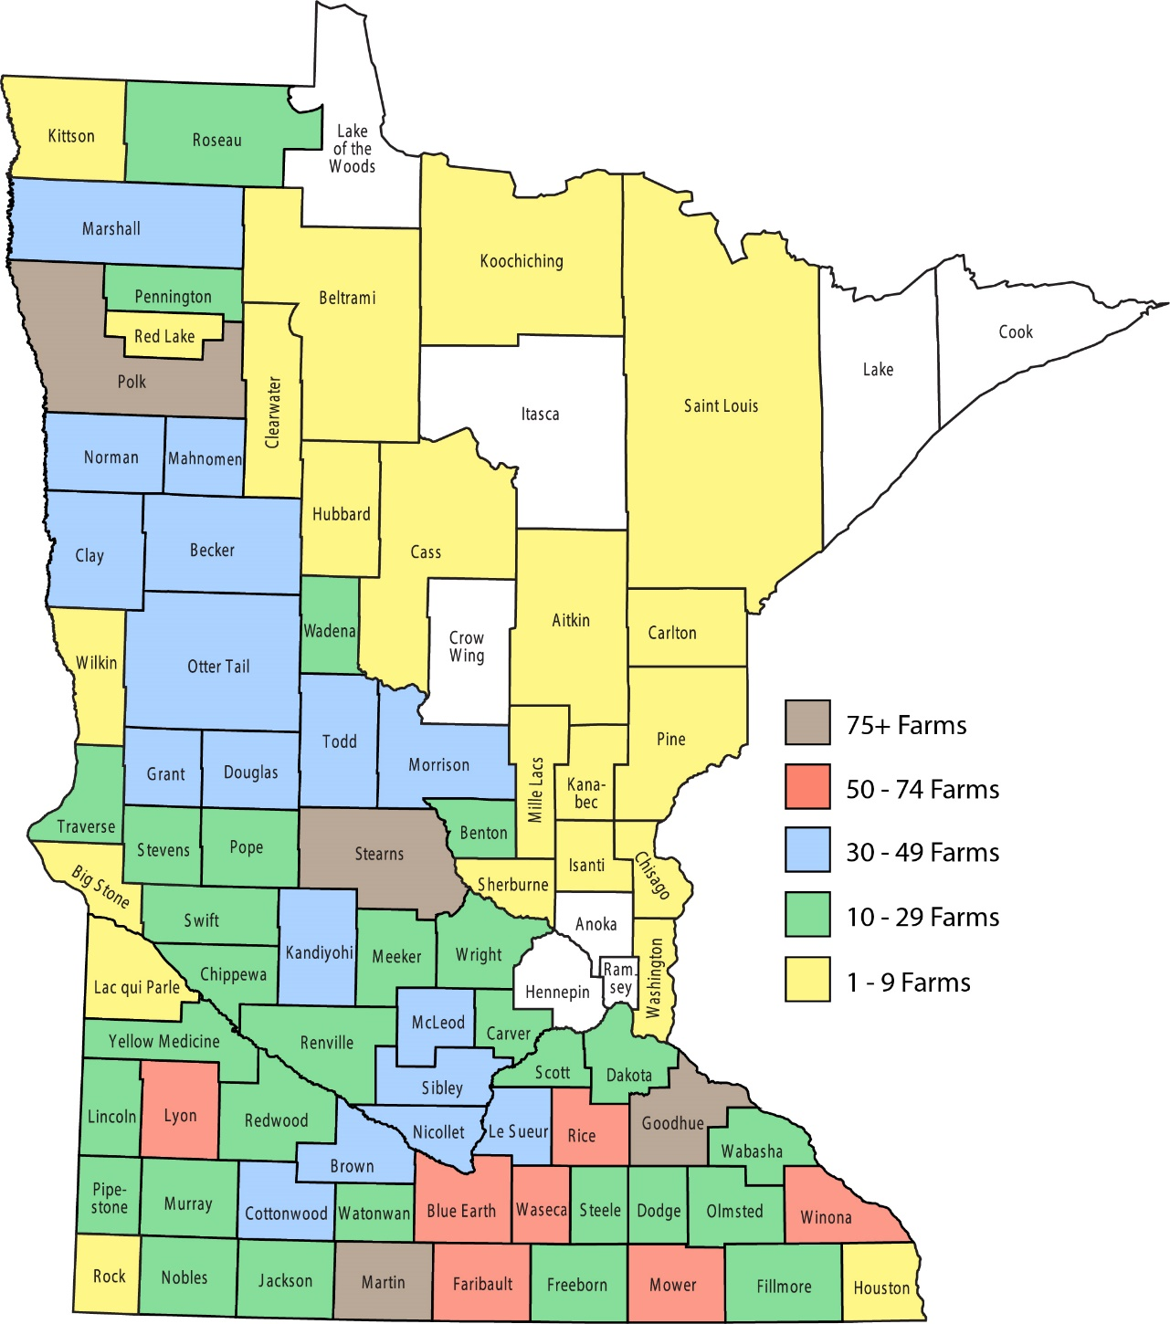
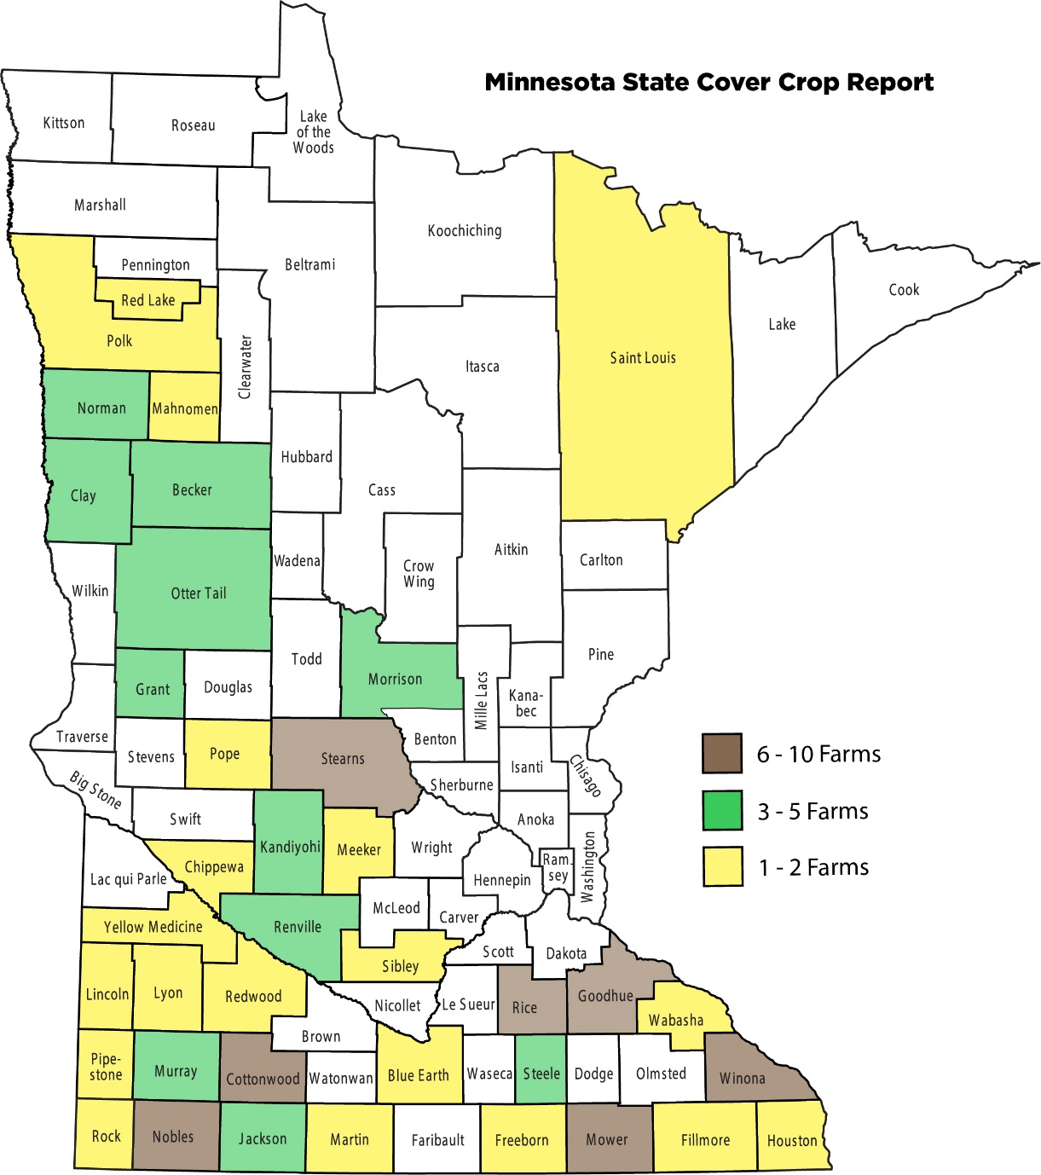
2022 Farm Business Management Financial Analysis by County

Slide 3
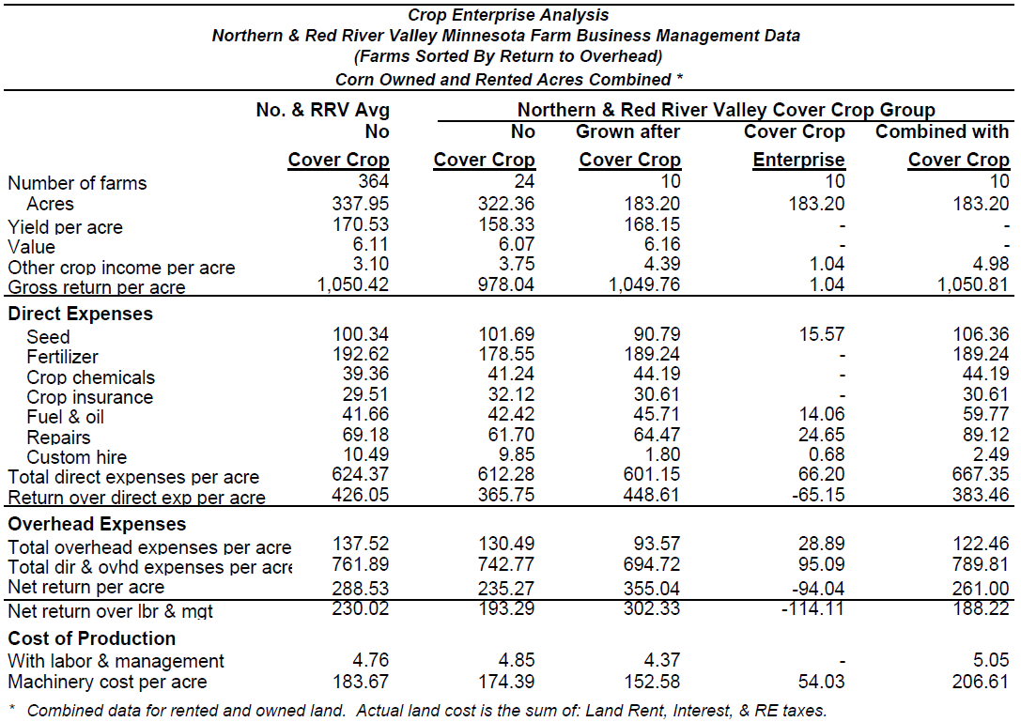

Slide 4
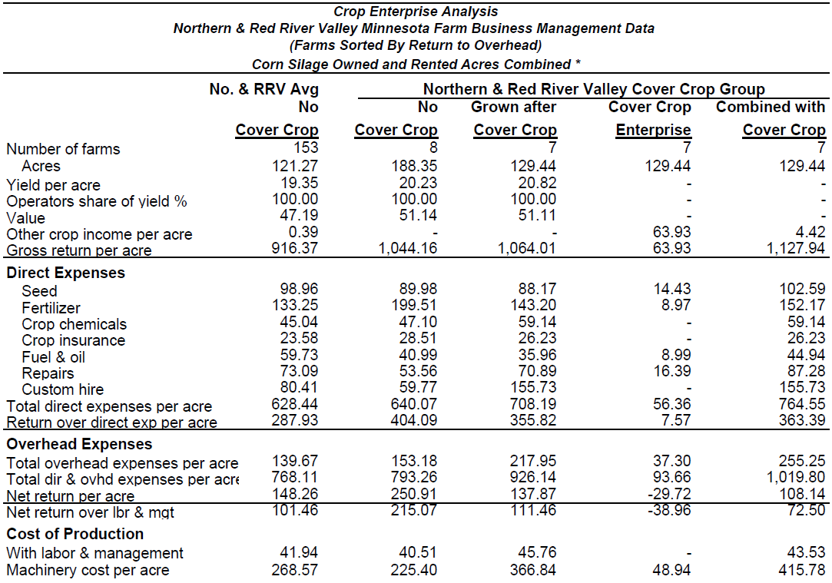

Slide 5
