Slide 1
2022 Livestock Year in Review
April 2023
Minnesota State Farm Business Management
Analysis Trend Data for Livestock
Compiled by Nate Converse
Central Lakes College Farm Business Management Instructor

Slide 2
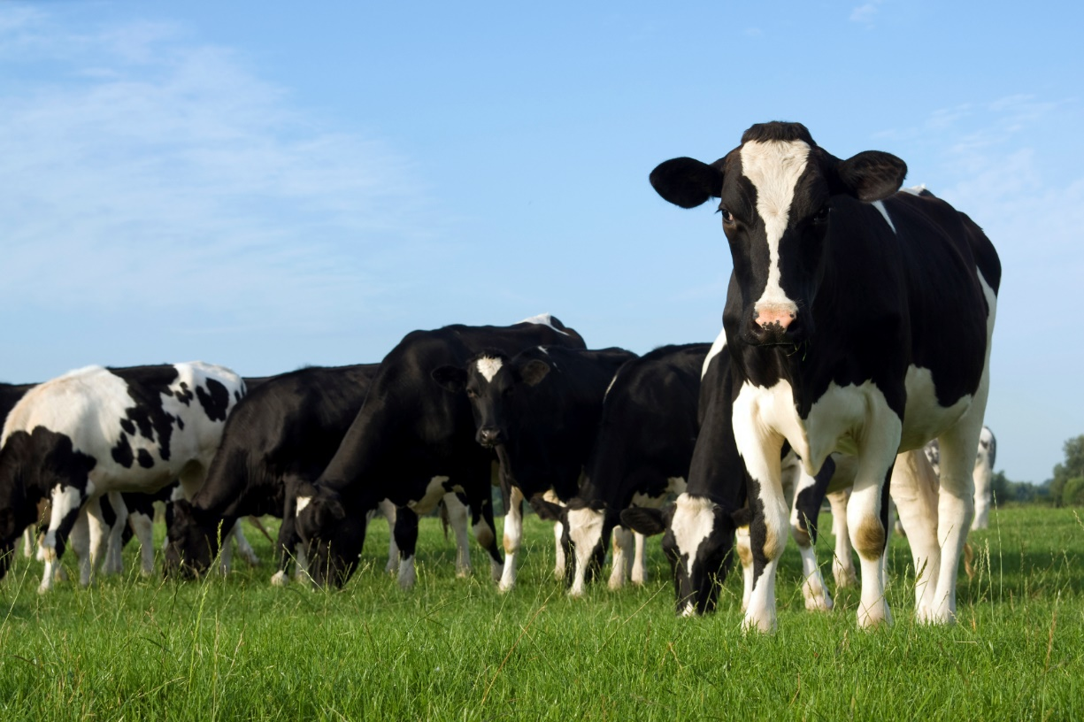
Livestock Enterprise Information
Dairy
  By Profitability
  By Herd Size
Beef
Hogs
Statewide Data

Slide 3
Livestock Enterprise Information
Dairy data on slides prior to
“Dairy by herd size” does
not include Organic Production

Slide 4
Number of Dairy Cows
Average Farm
Notes:
Excludes organic & transition

Slide 5
Milk Production per Cow

Slide 6
10 Year Production &
Net Return Trends per Cow (before labor & mgt)

Slide 7
Returns per CWT of Milk (before labor & mgt)

Slide 8
Returns per CWT of Milk (before labor & mgt)

Slide 9
20 Year Net Returns per Cow (before labor & mgt)

Slide 10
20 Year Net Returns per Cow (before labor & mgt)

Slide 11
Average Price on Milk Sold Excluding Organic Farms

Slide 12
Average Price on Milk Sold Excluding Organic Farms

Slide 13
Milk Price and Net Return

Slide 14
Average Price of Milk Sold and Class III

Slide 15
Average Basis over Class III

Slide 16
Some definitions before the dairy slides:
Gross Margin:
Milk value + Cull sales + Calf sales + Transferred value + Other income (includes gov payments) – Purchased – Transferred in – Replacement Heifer cost +/- Inventory change

Slide 17
Expenses:
Direct
  Feed
  Breeding
  Vet
  Supplies
  Fuel
  Repairs
  Custom
  Labor (some)
  Marketing
  Hauling
  Bedding
Overhead
  Labor (some)
  Leases
  Utilities
  Interest
  Depreciation

Slide 18
Dairy Cows –
Costs and Gross Margin per CWT
Net Returns: $2.69 $2.69 $5.36
Net w/Labor&Mgt: $1.93 $1.89 $4.49
Notes:
Excludes organic

Slide 19
Dairy Cows – 3-yr trends
Costs and Gross Margin per CWT
Net Returns: $3.86 $0.82 $2.69
Net w/Lbr&Mgt: $3.09 $0.16 $1.93

Slide 20
Dairy Cows –
Returns per Cow

Slide 21
Dairy Cows – 3-yr trend
Returns per Cow

Slide 22
Feed and non-feed costs – 3 yr trend

Slide 23
Cost of Production &
Milk Price – 8 year trend
Notes:
From State Dairy Exec Summary Data

Slide 24
Dairy Cows - MN Dairy Sort
Data by Size of Herd
-- Starting in 2018, Organic
is excluded unless noted--

Slide 25
Dairy Cows –
Number of Farms in database (excludes Organic)
Pg 3 & 4 - MN FBM Dairy Sort

Slide 26
Dairy Cows –
Number of Herds and Percent of MN Farms
MN FBM Dairy Sort
Herd data provided by the Minn Department of Ag.
Notes:
Note: The left chart shows the percent of each herd size in the state FBM database. The chart on the right shows what percent the FBM farms are of the total herds in the state. I.E. The 33 farms in the >500 cow group from the previous slide approximates 27% of the total number of large herds in the state.

Slide 27
Dairy Cows –
Farms as percent of all MN herds
MN FBM Dairy Sort

Slide 28
Minnesota Dairy Sort
Selected Factors - Size and Production
Pg 4 - MN FBM Dairy Sort

Slide 29
Minnesota Dairy Sort
Selected Factors - Cost and Price
Pg 3 - MN FBM Dairy Sort

Slide 30
Minnesota Dairy Sort
Selected Factors – Production Costs
Pg 3 - MN FBM Dairy Sort

Slide 31
Minnesota Dairy Sort
Hired Labor and Operator Labor/Mgmt
Pg 4 - MN FBM Dairy Sort

Slide 32
Minnesota Dairy Sort
Selected Factors – Term Debt Coverage
Pg 2 - MN FBM Dairy Sort

Slide 33
Minnesota Dairy Sort
Selected Factors – Operating Expense Ratio
Pg 2 - MN FBM Dairy Sort

Slide 34
Minnesota Dairy Sort
Selected Factors – Working Capital
Pg 2 - MN FBM Dairy Sort

Slide 35
Minnesota Dairy Sort
Selected Factors – Net Worth Factors
Pg 2 - MN FBM Dairy Sort

Slide 36
Minnesota Dairy Sort
Data by herd size
Pg 4 - MN FBM Dairy Sort

Slide 37
Additional Selected Sorts…
Pg 5 - MN FBM Dairy Sort
Notes:
All includes all dairy (organic and transition)
Robotic dairy excludes: All non-robotic herds
Non- Robotic, Traditional excludes: Organic, transition, grazing, 3x, and robotics
Non-Robotic, 3x excludes: Organic, transition, grazing, robotics, and non-3x herds
Organic excludes: All non-organic herds
Dairy Initiatives excludes: All non-Dairy Initiative herds

Slide 38
Dairy Farms – EBIDTA per Cow & Cwt
Notes:
This data is calculated using farms that have at least 70% of their gross farm income from dairy and who also completed a dairy enterprise analysis. For 2022, this includes 202 farms. The sum of the EBITDA is divided by the sum of the cow numbers and sum of milk produced.

Slide 39
Dairy Farms – DEBT per Cow & Cwt
Notes:
This data is calculated using farms that have at least 70% of their gross farm income from dairy and who also completed a dairy enterprise analysis. For 2022, this includes 202 farms. The sum of the Total Debt is divided by the sum of the cow numbers and sum of milk produced.

Slide 40
Dairy Farms – DEBT per Cow & Cwt adjusting for crop income
Notes:
This table adjusts for crop sales. Over these three years, about 5% of the gross farm income was from crop sales. This chart takes the Debt x the 95% of farm income from livestock x the Debt / the total number of cows or total CWT

Slide 41
Dairy Farms – DEBT Payment per Cow & Cwt Total & Adjusting for crop income (2022 Data)
Notes:
This table shows the Debt payments on a per cow and per CWT basis. The Adj for Crop Income column adjusts for the % of the total farm income from crop sales. This number will be lower as it speculates that some of the debt payments are serviced by crop sales income.
The data is calculated from the total debt payments/total cow numbers and total debt payments/total cwt produced. This data includes farms that have at least 70% of gross farm income from dairy and who also completed a dairy enterprise analysis. In 2022, this data includes 202 farms.

Slide 42
Net Return per Cow – Organic Farms
Pg 5 – MN FBM Dairy Sort

Slide 43
Average Price on Milk Sold Organic Farms
Pg 5 – MN FBM Dairy Sort

Slide 44
Dairy Herd Size
Organic Farms
Pg 5 – MN FBM Dairy Sort

Slide 45
Pounds of Milk per Cow
Organic Farms
Pg 5 – MN FBM Dairy Sort

Slide 46
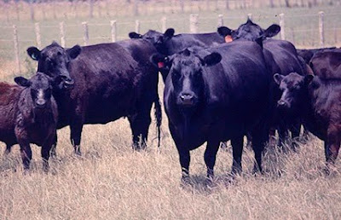
Beef Cow/Calf Enterprise
Information

Slide 47
Beef Cow-Calf Returns -
Net Return per Cow
Notes:
Beef excluding backgrounding. Before labor & mgt

Slide 48
Beef Cow-Calf – (excluding backgrounding)
Costs and Returns of Production per Cow
Net Returns: -$236 -$143 $183
w/ Lbr&Mgt: -$374 -$220 $48
Notes:
Excluding backgrounding

Slide 49
Beef Cow-Calf – (including backgrounding)
Costs and Returns of Production per Cow
Net Returns: -$182 -$360 -$182 -$156 -$28
w/ Lbr&Mgt -$315 -$548 -$331 -$270 -$125

Slide 50
Beef Cow-Calf –
Select Factors
Notes:
The high 20% return farms consistently have a higher weaning percentage, resulting in more Lb weaned per exposed female. The high return group also has consistently lower feed costs.

Slide 51
Beef Cow-Calf –
With & Without Backgrounding per Cow
Net Returns: -$236 -$82

Slide 52
Beef Cow-Calf –
With & Without Backgrounding per Cow

Slide 53
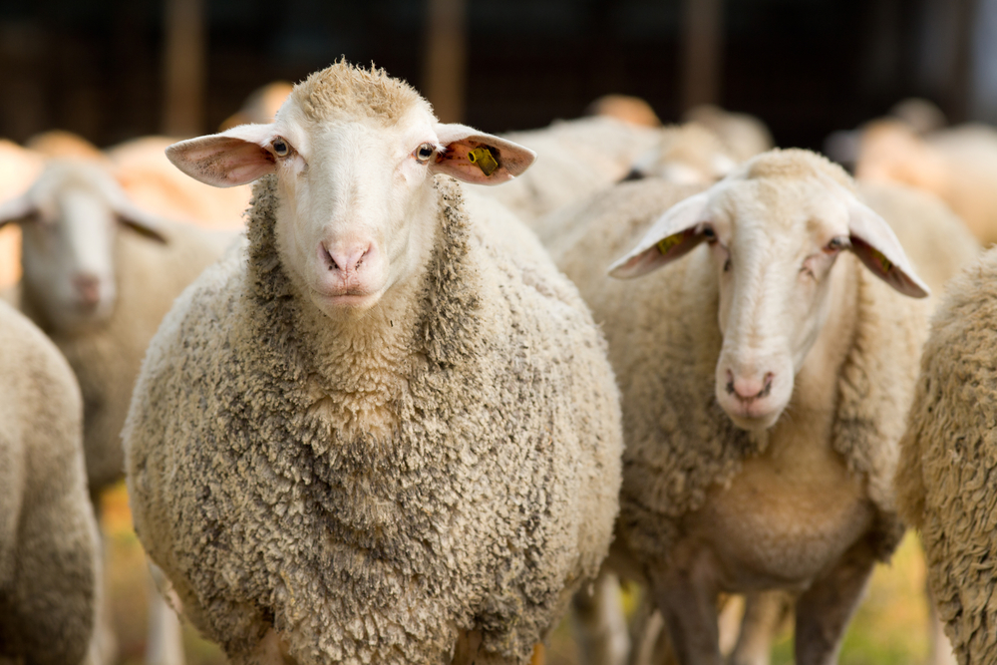
Sheep Enterprise Information

Slide 54
Sheep – Market Lamb Production
Per Ewe – 2 year trend
Net Returns: $123 -$85

Slide 55
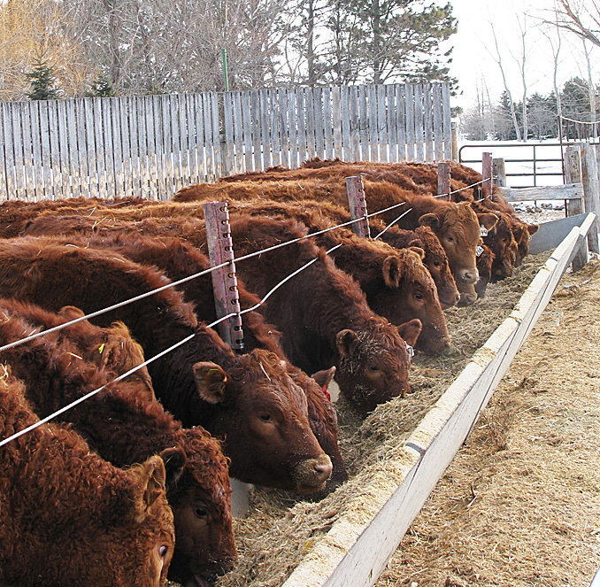
Beef & Dairy Finishing Enterprise Information

Slide 56
Dairy Finishing –
Price per Cwt up, Net Return higher
Notes:
Net Return before labor & mgt

Slide 57
Dairy Finishing –
Feed Cost per cwt of gain & Net Return per CWT
Notes:
Net Return before labor & mgt

Slide 58
Beef Finishing Returns -
Net Return per CWT

Slide 59
Beef Finishing –
Feed Cost per cwt of gain & Net Return per CWT
Notes:
Net Return before labor & mgt

Slide 60
Beef Finishing
Average Weight Sold

Slide 61
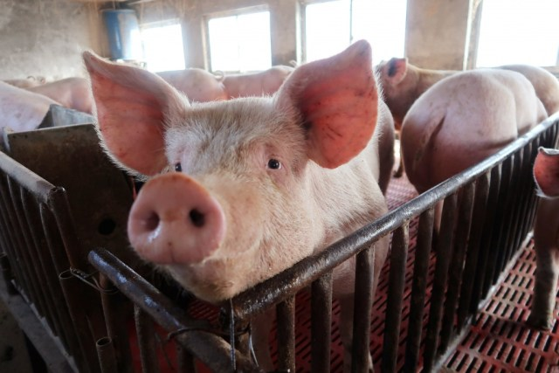
Hog Enterprise Information

Slide 62
Finish Feeder Pigs –
Net Return & Price per Cwt

Slide 63
Weaning to Finish Hogs–
Net Return & Price per Head

