Slide 1
2022 Dairy Special Sorts
April 2023
Minnesota State Farm Business Management
Analysis Trend Data for Dairy
Compiled by Nate Converse
Central Lakes College Farm Business Management Instructor

Slide 2
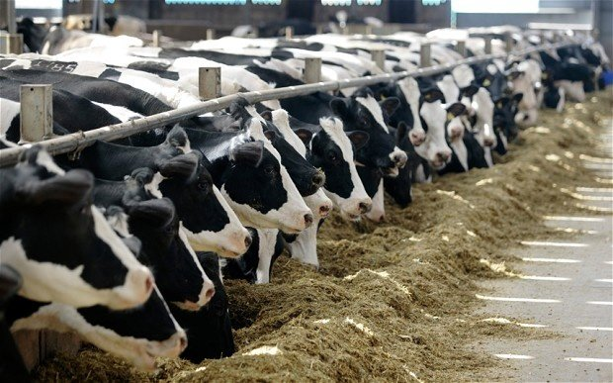



Slide 3
Dairy Special Sort Section 2022
21 Herds
243 Herds
 | Organic | All Dairy Excluding Organic
Pounds of Milk | 15,311 | 25,485
Price Received | $30.58 | $24.24
Return/Cow | $616.49 | $686.22
Protein&Fat/Cow | 1,202 | 1,854
Notes:
Return/Cow before owner Labor & Mgt Charge

Slide 4
Dairy Special Sort Section 2022
21 Herds
243 Herds
 | Organic | All Dairy Excluding Organic
Feed Cost/CWT | $14.21 | $11.41
Total Direct/CWT | $20.91 | $17.17
Dir&Ovhd/CWT | $25.09 | $19.83
Lb. of Milk/FTE (median) | 1,010,266 | 1,914,207
Notes:
Return/Cow before owner Labor & Mgt Charge

Slide 5
Dairy Special Sort Section 2022
25 Herds
187 Herds
 | 3X Milking | Non 3X Milking non Organic
Pounds | 27,811 | 24,327
Price | $24.57 | $24.11
Return/Cow | $963.25 | $542.10
Turnover Rate | 30.7% | 36.9%

Slide 6
Dairy Special Sort Section 2022
25 Herds
187 Herds
 | 3x Milking | Non 3x, or organic
Feed Cost/CWT | $11.14 | $11.49
Total Direct/CWT | $17.57 | $17.07
Dir&Ovhd/CWT | $19.75 | $19.83
Lb. of Milk/FTE (median) | 1,741,716 | 1,868,844
Total Labor Cost/CWT (with owner labor & mgt) | $2.95 | $2.74
Notes:
Return/Cow before owner Labor & Mgt Charge

Slide 7
Dairy Special Sort Section 2022
61 Herds
243 Herds
 | Dairy Initiative | Dairy, Non-Organic
Pounds | 24,280 | 25,485
Price | $24.84 | $24.24
Return/Cow | $700.37 | $686.22
Feed Cost/CWT | $11.65 | $11.41

Slide 8
Dairy Special Sort Section 2022
25 Herds
187 Herds
 | Robotic | Non Robotic 2X
Milk Sold | $6,489.90 | $5,840.31
Direct Costs | $4,512.02 | $4,152.24
Overhead Cost | $926.58 | $672.90
Hired Labor | $293.49 | $449.28

Slide 9
Dairy Special Sort Section 2022
28 Herds
187 Herds
 | Robotic | Non Robotic 2x
Pounds | 27,236 | 24,327
Price | $24.08 | $24.11
Return/Cow | $898.67 | $542.10
Turnover Rate | 39.7% | 36.9%
Notes:
Return before labor & mgt charge

Slide 10
Dairy Special Sort Section 2022

Slide 11
Dairy Special Sort Section 2022
Robotic/2x Comparison (Labor Efficiency)
 | Robotic | 2X | 3X | Difference (v 2X)
Labor Hrs/Cow | 28.85 | 34.44 | 43.25 | 84%
Milk/FTE | 2,613,124 | 1,868,844 | 1,741,716 | 140%

