Slide 1
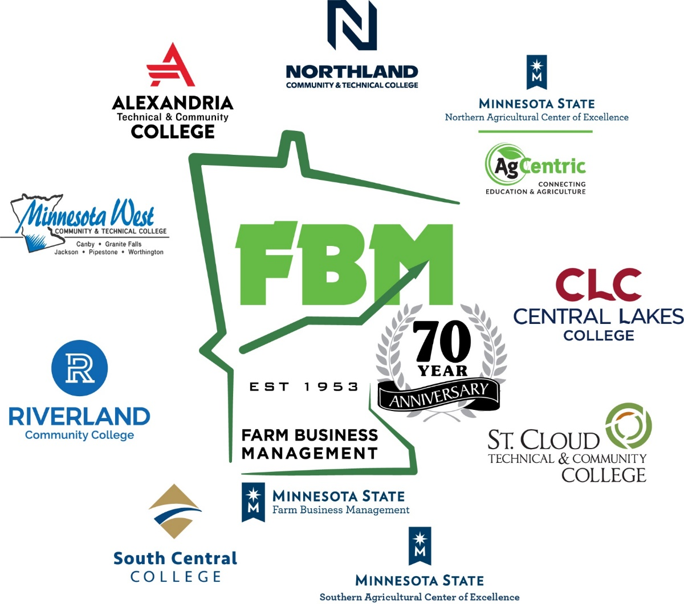
Farm Business Management
Celebrates 70 years
Established in 1953

Slide 2

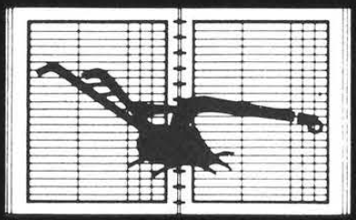

Farm Business Management
Celebrates 70 years
Established in 1953
What if we had an ongoing educational program for farmers?
Before the computer, hand input of records and hand-calculated analysis guided decisions impacting the work focus on the farm
Portable computers brought electronic records and an electronic analysis that was completed on the farm
Adjusting to changes in Agriculture & Education, the program celebrates its 70th years.
A design based on the Veterans On-farm Training program that started after WWII
Notes:
In the early 1950s, a plan developed to make an on-farm training education program available after the Veteran’s program would be terminated.
Everything was done by hand in the early years until a “send away” electronic analysis started in the middle 60s.
1985, and the Farm Crisis, brought about a huge change in the program. Luggable, portable computers (much like carrying a portable sewing machine) and FINPACK software arrived. Decision making could result from reports developed that day.
Through the challenges of managing a unique, individual-student-focused program in a state higher education system…FBM has survived and thrived.

Slide 3
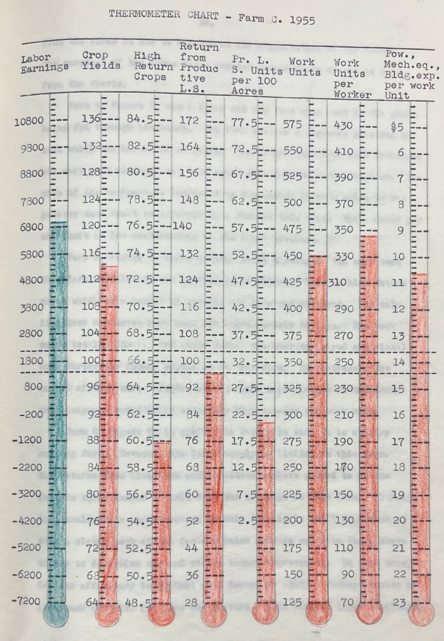
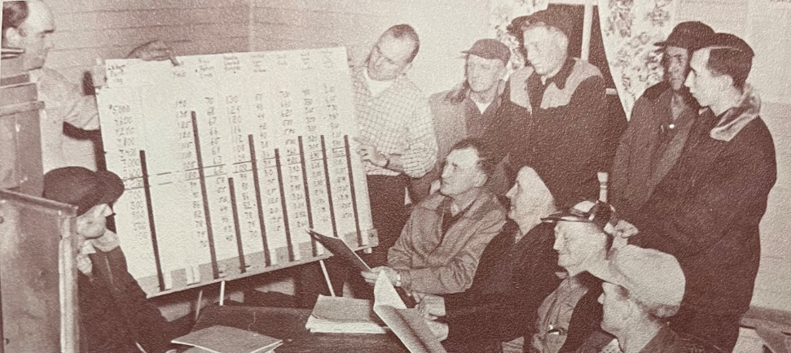
A Look at our History…
1953 – Initial funding pursued and received
The 1950s…
  First annual reports published in April of 1956
Small group instruction – What does the analysis show us?
The Thermometer Chart – Key Management Factors: How do you compare to the benchmark?
Notes:
Lets take a quick look at the 7 decades of FBM history
1953 – Program receives initial funding from several stakeholders
The Veterans Coop On-Farm training program was in full swing after WWII
That program set the stage for the idea of a regular Farm Management program offered by local high schools
The HS Ag instructor could work with several farmers and new programs could be established
The 1950s…
First official annual reports published for the 1955 calendar year, in April of 1956
Classes were held to teach farm management and explain the importance of a business analysis
The first Financial Scorecard was the Thermometer Chart. 8 factors that would provide key insight into business success

Slide 4
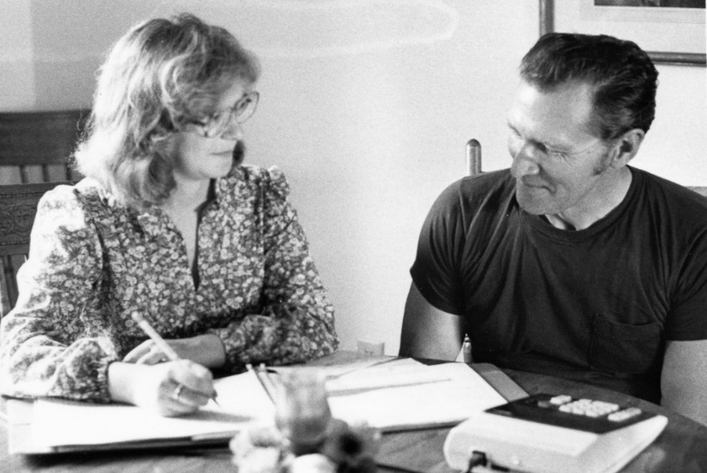
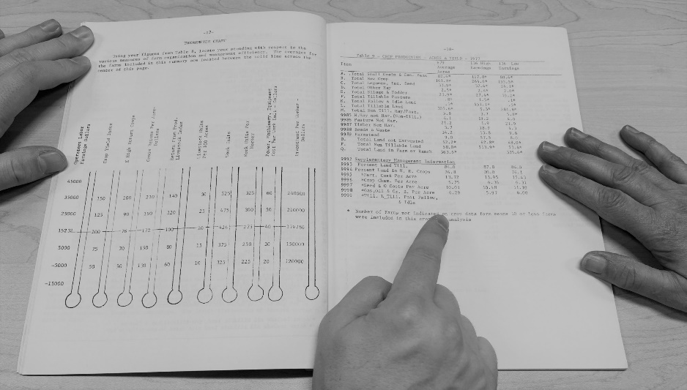
A Look at our History…
The 1960s…
  Statewide coordination begins in 1960
  The first electronic farm business analysis in 1965
Getting the Account Book entries right for the analysis
Highlighting business strengths in the analysis
Notes:
The 1960s…
Statewide coordination officially begins in 1960
The Ag Coordinator position is officially funded and designed to work across regions, developing a leadership team
Prior to that, lead teachers were selected to assist with the analysis processing but did not have coordination duties
The first electronic farm business analysis is successfully tested in 1965, and usage continued for 30 years
From 1955 to 1964, the analysis was completed using hand calculations, effective but not efficient
Electronic analysis promised better accuracy and ease of processing
It was a difficult transition…computer processing was in a different world than today
That basic process: enter data into an input form, send the forms to a processing company, and wait for the analysis to be returned by mail. Then check for accuracy and share with students.

Slide 5
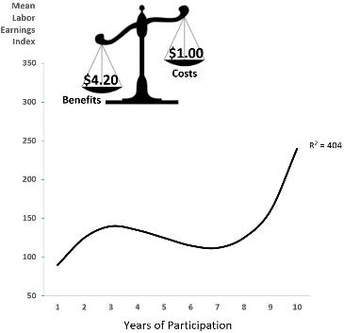

A Look at our History…
The 1970s…
  The first statewide curriculum in 1970
  Veterans Farm Management begins in 1973
  State regulations challenge future of the program
More consistent delivery of FBM education across the state
Charting the benefits of the program
Notes:
The 1970s…
The first statewide curriculum is rolled out in 1970
Instruction had been similar across the state but there was no official guide to uniform instruction
The Veterans Farm Management program begins in 1973 and greatly expands FBM delivery
After the Vietnam War, Veterans Farm Management was brought back
This program was very successful and set up a foundation for expanding Farm Business Management in High Schools and AVTIs
State regulations challenge the future of the program but partners support the program for long term stability
State regulations were interpreted in such a way that FBM would be more difficult to offer
After numerous stakeholder meetings and state agency contacts, the interpretation was modified
This set the stage for program viability for many years
The chart and balance bar was used for many years to demonstrate the value of the program in terms of programs costs and the resulting financial benefit to the community were programs exist

Slide 6
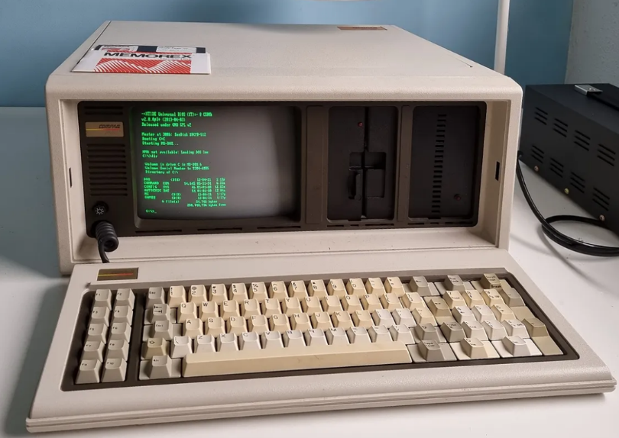
A Look at our History…
The 1980s…
  A new State Board of Vocational Technical Education starts in 1983
  The Omnibus Bill of 1985 moves FBM into the “at-the-farm” analysis era
Area Vocational
Technical Institute
(AVTI)
Farm Business
Management
Programs
Local Independent
School District (ISD)
FBM is now administered by two different governing bodies
The portable, AKA luggable, computer
Notes:
The 1980s…
A new State Board of Vocational Technical Education starts in 1983
This separated control and oversight of HS and AVTI FBM program. Some were offered through the HS, others through the AVTI.
This separation was in play for many years
The Omnibus Bill of 1985 moves FBM into the “at-the-farm” analysis era
The Farm Crisis of the early 80s caused major discussions in the state legislature as farmers were struggling
This bill providing portable computers & FINPACK to Farm Business Management instructors, some HS instructors, and Extension agents
The computer and analysis could now go to the farm for gathering data and making decisions
Financial data was easier to share with lenders and other stakeholders

Slide 7
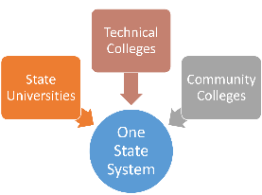
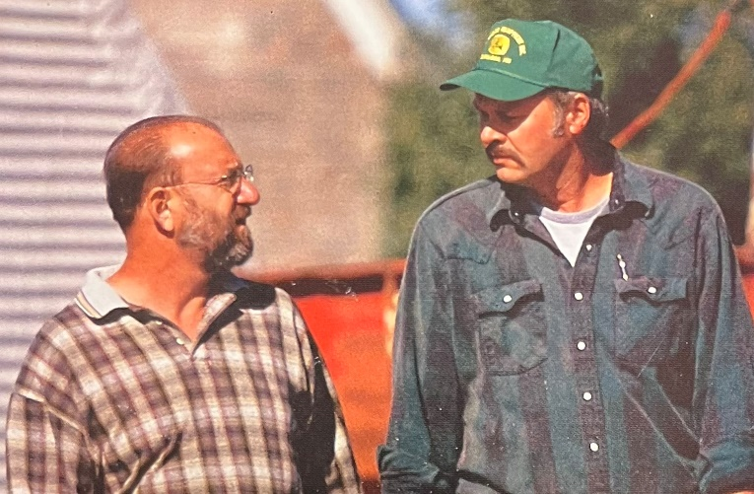
A Look at our History…
The 1990s…
  In 1990 legislature forms the Minnesota State Colleges & Universities
  Hourly-based instruction is converted to a credit-based - 1992
  The college and university merger occurs in 1995
  FINPACK analysis adopted statewide in 1996
  The Rural Mental Health program begins in 1998
Additional Farmer Support - 1998
MnSCU begins - 1995
Notes:
The 1990s…
In 1990 legislative action is taken to plan the formation of the Minnesota State Colleges & Universities
After years of separation, the mandate came to merge the colleges and universities in the next few years
A major time of challenge, uncertainty, and unrest in both systems
Hourly-based instruction is converted to a credit-based curriculum in 1992
With the merger impending, FBM had to move into the official higher education model
Hour-based instruction would not fit in a credit-based program
Statewide design by instructors across the state established a credit system
The college and university merger occurs in 1995
Officially the MnSCU system began
One state governing board guided all FBM programs
The remaining HS programs were transferred into the state system
FINPACK adopted statewide as the analysis program in 1996
A 3-year pilot project in 1991 compared the current SDS program with FINPACK
Considerations were given to the fact that FINPACK had become the most used program in the FBM instructor toolbox. It was used yearround, rather than once a year like the SDS program.
Most regions converted in 1994 but all did by 1996
The Rural Mental Health program begins in 1998
Ted Matthews (photo) has been there from the beginning
This program was legislatively funded to address significant stress on farmers in the mid 90s
It is one of a kind in the nation and nationally recognized for its success

Slide 8
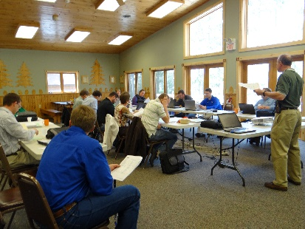
A Look at our History…
The 2000s…
  A 2000 research study reaffirms program value
  2000 - Professional Enhancement Program begins
  The 50th Anniversary is celebrated in 2003
Mentorship for New Instructors - 2000
50th Anniversary – 2003
Notes:
The 2000s…
A 2000 research study reaffirms program value
After 6 years in the new MnSCU system, it was time to look to students and stakeholders for input on the value of the program
This decade would result in numerous changes to and questions about the program due to the ever tightening funding structure
This study provided strong evidence of the programs value to MN
2000 - Professional Enhancement Program begins
Many FBM instructors were retiring and instructors were managing the program in a new environment
This made it more difficult for new instructors to get established in the position without additional support
PEP was that support and continues to this day
The 50th Anniversary is celebrated in 2003
This was a milestone for a program that had weathered the storm of transition from a local, HS supported program, to a state-managed program.
Value can be seen at the local level…the move away from that control can stifle normal programs
FBM had moved into each new environment and remained successful statewide.

Slide 9




A Look at our History…
The 2010s…
  A 2010 statewide task force builds FBM program awareness
  2012 & 2014 - Centers of Excellence in Agriculture established
  2015 - Legislature funds support for FBM through MDA and MAELC
Notes:
The 2010s…
A 2010 statewide task force builds FBM program awareness with new college administration and new stakeholders
Long time college presidents were retiring and being replaced with people from out of state
Other long time local college administrators, as a result, would also change based the new presidents expectations
FBM has always been a “gray area” program because it is delivered differently and requires additional funding
This task force would build awareness and explain concepts to the new leadership
The Centers of Excellence in Agriculture are established in 2012 & 2014
The 2000s was a time of extreme pressure for FBM instructors and Management Deans due to leadership changes and funding challenges
In 2012, the last two full time Deans retired and 2 other Deans experienced position changes
At the same time, due to funding, structure changes, and decisions by new college presidents…the State Director of Management Programs position went away
The Centers would be the future leadership of FBM
In 2015, legislative support provides critical funding through MDA and MAELC to support FBM
FBM is a unique program in higher education and requires unique support
The legislature, after an ambitious “Sustain and Grow” campaign, provided funding
This came the form of challenge grants from MAELC that provided a process to spread these funds to all programs
Those funds diminished the financial pressure on the program at the local college

Slide 10

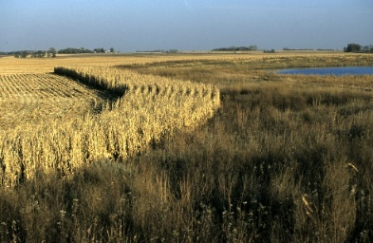
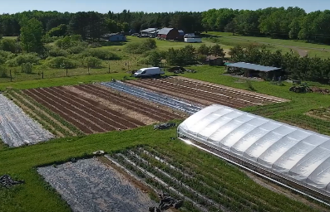
A Look at our Future…
The 2020s…
  New opportunities expanded with new partnerships:
    Organic
    Environmental / Water Quality / Cover Crop
    Specialty Crop
    Urban farming
  Continued focus on the needs of Greater Minnesota Producers
  Enhancing program design to be resilient in the ever changing agricultural and educational environments
Notes:
The 2020s…
New opportunities expanded with new partnerships:
Organic
Environmental / Water Quality / Cover Crop
Specialty Crop
Urban farming
All are looking for data that only the FBM program and students can provide
This increases both program support and awareness
As consumer transparency expectations increase, these partnerships will become more important
National attention has been drawn to this program because of the high quality and comprehensive nature of the FBM data
National interest will continue for finding ways to spread the model across the country in some way
MN FBM is in a unique place to, FIRST, EDUCATE & SUPPORT STUDENTS, and SECONDLY, provide value to the agriculture community as a whole

Slide 11

Farm Business Management
Celebrates 70 years
Celebration Planned
September 11, 2023
Holiday Inn & Suites
St. Cloud, MN.
4:30 p.m. to 8:00 p.m.

