Slide 1
2023 Livestock Year in Review
April 2024
Minnesota State Farm Business Management
Analysis Trend Data for Livestock

Slide 2
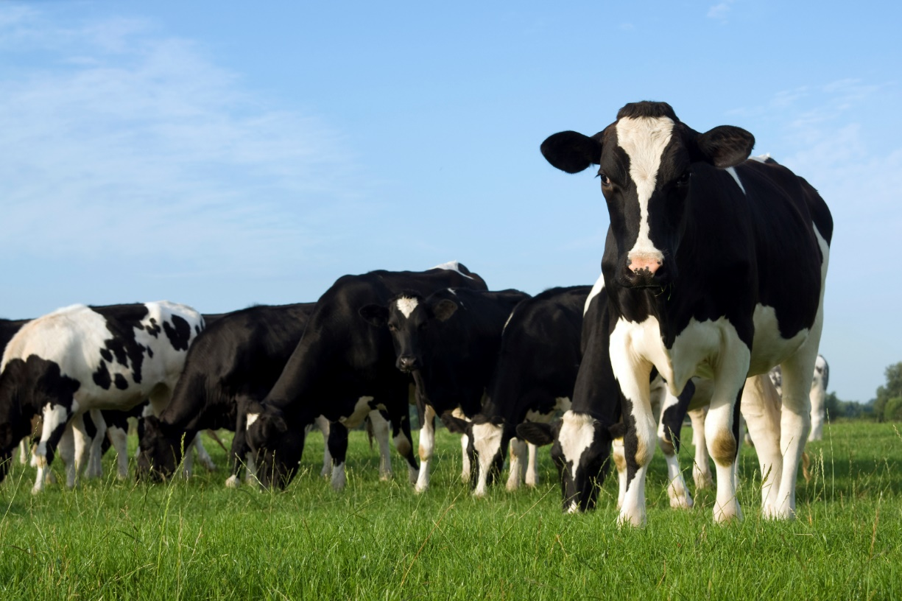
Livestock Enterprise Information
Statewide Data
Dairy
  By Profitability
  By Herd Size
Beef
Hogs

Slide 3
Livestock Enterprise Information
Dairy data on slides prior to
“Dairy by herd size” does
not include Organic Production

Slide 4
Number of Dairy Cows Average Farm
Notes:
Excludes organic & transition

Slide 5
Milk Production per Cow

Slide 6
Energy Corrected Milk Production per Cow

Slide 7
10 Year Production &
Net Return Trends per Cow (before labor & mgt)

Slide 8
Returns per CWT of Milk (before labor & mgt)

Slide 9
20 Year Net Returns per Cow (before labor & mgt)

Slide 10
20 Year Net Returns per Cow (before labor & mgt)

Slide 11
10 Year Net Returns per Cow (before labor & mgt)

Slide 12
Average Price on Milk Sold Excluding Organic Farms

Slide 13
Average Price After Hauling on Milk Sold Excluding Organic Farms

Slide 14
Average Price on Milk Sold Excluding Organic Farms

Slide 15
Milk Price and Net Return

Slide 16
Average Price of Milk Sold and Class III

Slide 17
Average Basis over Class III

Slide 18
Average Price of Milk Sold vs DMC All Milk Price

Slide 19
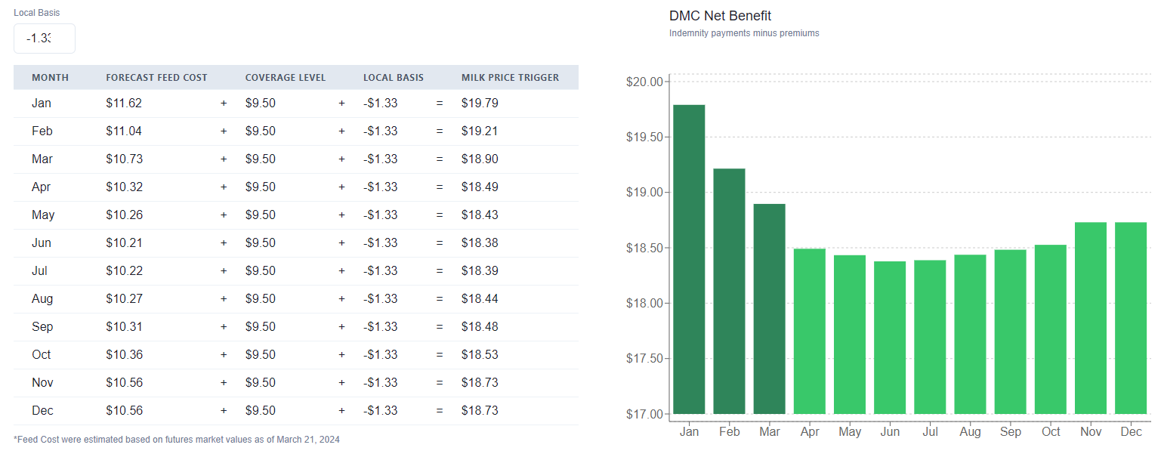
DMC Milk Price Trigger Estimates for 2024

Slide 20
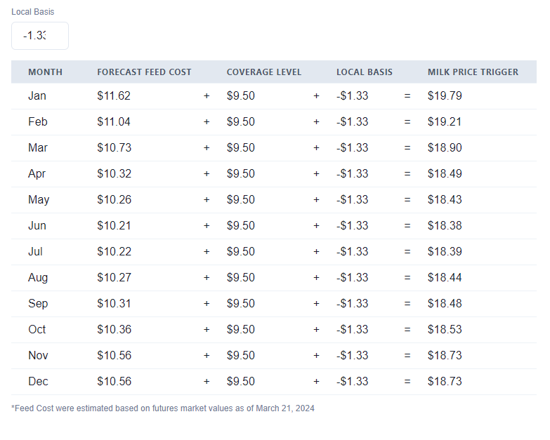
DMC Milk Price Trigger Estimates for 2024
Avg = $18.71

Slide 21
FBM Feed Cost vs DMC Feed Cost (per CWT)

Slide 22
Expenses:
Direct
  Feed
  Breeding
  Vet
  Supplies
  Fuel
  Repairs
  Custom
  Labor (some)
  Marketing
  Hauling
  Bedding
Overhead
  Labor (some)
  Leases
  Utilities
  Interest
  Depreciation

Slide 23
Dairy Cows –
Costs and Gross Margin per CWT
Notes:
Excludes organic

Slide 24
Dairy Cows –
Costs and Gross Margin per Cow
Notes:
Excludes organic. Dairy Repl cost includes transferred in, purchased, and inventory change

Slide 25
Comparison by Profitability Group
-Key Factors
 | Low 20% | Median | High 20%
Energy Corrected Milk | 26,835 | 28,867 | 29,319
Replacement Costs | $3.20/CWT | $2.45/CWT | $2.25/CWT
Feed Costs | $11.35/CWT | $10.15/CWT | $10.26/CWT
Feed Costs/Cow | $2,768 | $2,674 | $2,745
Lbs of Fat & Protein/Cow | 1,825 | 1,961 | 1,987
Milk Price | $18.67 | $19.01 | $20.36
Milk Price after Hauling | $18.18 | $18.52 | $20.07

Slide 26
Dairy Cows – 3-yr trend
Returns per Cow

Slide 27
Feed and non-feed costs – 3 yr trend

Slide 28
Feed and non-feed costs – 3 yr trend with labor and replacement cost

Slide 29
Cost of Production &
Milk Price –
Notes:
From State Dairy Exec Summary Data

Slide 30
Dairy Cows - MN Dairy Sort
Data by Size of Herd
-- Starting in 2018, Organic
is excluded unless noted--

Slide 31
Dairy Cows –
Number of Farms in database
Pg 3 & 4 - MN FBM Dairy Sort

Slide 32
Dairy Cows –
Number of Herds and Percent of MN Farms
MN FBM Dairy Sort
Herd data provided by the MN Department of Ag.
Notes:
Note: The left chart shows the percent of each herd size in the state FBM database. The chart on the right shows what percent the FBM farms are of the total herds in the state. I.E. The 33 farms in the >500 cow group from the previous slide approximates 27% of the total number of large herds in the state.

Slide 33
Dairy Cows –
Farms as percent of all MN herds
MN FBM Dairy Sort

Slide 34
Minnesota Dairy Sort
Selected Factors - Size and Production
Pg 4 - MN FBM Dairy Sort

Slide 35
Minnesota Dairy Sort
Selected Factors - Cost and Price
Pg 3 - MN FBM Dairy Sort

Slide 36
Minnesota Dairy Sort
Selected Factors – Production Costs
Pg 3 - MN FBM Dairy Sort

Slide 37
Minnesota Dairy Sort
Hired Labor and Operator Labor/Mgmt
Pg 4 - MN FBM Dairy Sort

Slide 38
Minnesota Dairy Sort
Selected Factors – Term Debt Coverage
Pg 2 - MN FBM Dairy Sort

Slide 39
Minnesota Dairy Sort
Selected Factors – Operating Expense Ratio
Pg 2 - MN FBM Dairy Sort

Slide 40
Minnesota Dairy Sort
Selected Factors – Working Capital
Pg 2 - MN FBM Dairy Sort

Slide 41
Minnesota Dairy Sort
Selected Factors – Net Worth Factors
Pg 2 - MN FBM Dairy Sort

Slide 42
Minnesota Dairy Sort
Data by herd size
Pg 4 - MN FBM Dairy Sort
Herd Size | State Ave. | up to 50 cows | 51-100 cows | 101-200 cows | 201-500 cows | over 500 cows
Number of Farms | 249 | 16 | 55 | 75 | 65 | 38
Ave # of Cows | 288.0 | 40.3 | 76.5 | 140.0 | 309.9 | 953.0
Milk Prod. Per Cow | 25,918 | 18,485 | 21,527 | 23,408 | 25,711 | 27,404
Feed Cost per Cwt | 10.73 | 11.42 | 11.37 | 11.10 | 10.63 | 10.61
Interest per Cwt | 0.41 | 0.48 | 0.53 | 0.50 | 0.42 | 0.38
Vet, Breeding & Supplies / Cwt | 1.46 | 1.73 | 1.33 | 1.28 | 1.18 | 1.19
Hired Labor per Cwt | 2.04 | 0.48 | 0.55 | 0.99 | 1.95 | 2.50
Deprec/Lease per Cwt | 0.77 | 1.51 | 1.32 | 0.96 | 1.07 | 1.09
Milk Price per Cwt | 19.14 | 18.12 | 18.62 | 18.88 | 19.23 | 19.22
Dir & Ovhd Cost per Cwt | 19.29 | 20.29 | 19.08 | 19.27 | 19.24 | 19.33
Return over Dir & Ovhd per Cow | 37 | -155 | 84 | 136 | 142 | -52
Herd Profit over Dir&Ovhd | 10,696 | -6,246 | 6,396 | 19,030 | 44,158 | -49,651
Owner Labor&Mgt per Cwt | 0.74 | 2.58 | 1.78 | 1.18 | 0.86 | 0.45
Net per Cow after Labor&Mgt | -155 | -633 | -299 | -140 | -79 | -176
Herd Profit over Labor&Mgt | -44,646 | -25,498 | -22,906 | -19,576 | -24,498 | -168,109

Slide 43
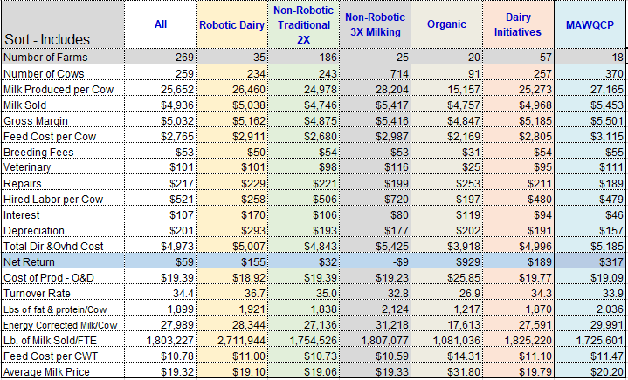
Additional Selected Sorts…
Pg 5 - MN FBM Dairy Sort
Notes:
All includes all dairy (organic and transition)
Robotic dairy excludes: All non-robotic herds
Non- Robotic, Traditional excludes: Organic, transition, grazing, 3x, and robotics
Non-Robotic, 3x excludes: Organic, transition, grazing, robotics, and non-3x herds
Organic excludes: All non-organic herds
Dairy Initiatives excludes: All non-Dairy Initiative herds

Slide 44
Dairy Farms – EBIDTA per Cow & Cwt
Notes:
This data is calculated using farms that have at least 70% of their gross farm income from dairy and who also completed a dairy enterprise analysis. For 2022, this includes 202 farms. The sum of the EBITDA is divided by the sum of the cow numbers and sum of milk produced.

Slide 45
Dairy Farms – DEBT per Cow & Cwt
Notes:
This data is calculated using farms that have at least 70% of their gross farm income from dairy and who also completed a dairy enterprise analysis. For 2022, this includes 202 farms. The sum of the Total Debt is divided by the sum of the cow numbers and sum of milk produced.

Slide 46
Dairy Farms – DEBT per Cow & Cwt adjusting for crop income
Notes:
This table adjusts for crop sales. Over these three years, about 5% of the gross farm income was from crop sales. This chart takes the Debt x the 95% of farm income from livestock x the Debt / the total number of cows or total CWT

Slide 47
Dairy Farms – DEBT Payment per Cow & Cwt Total & Adjusting for crop income (2023 Data)
Notes:
This table shows the Debt payments on a per cow and per CWT basis. The Adj for Crop Income column adjusts for the % of the total farm income from crop sales. This number will be lower as it speculates that some of the debt payments are serviced by crop sales income.
The data is calculated from the total debt payments/total cow numbers and total debt payments/total cwt produced. This data includes farms that have at least 70% of gross farm income from dairy and who also completed a dairy enterprise analysis. In 2022, this data includes 202 farms.

Slide 48
Net Return per Cow – Organic Farms
Pg 5 – MN FBM Dairy Sort

Slide 49
Average Price on Milk Sold Organic Farms
Pg 5 – MN FBM Dairy Sort

Slide 50
Dairy Herd Size
Organic Farms
Pg 5 – MN FBM Dairy Sort

Slide 51
Pounds of Milk per Cow
Organic Farms
Pg 5 – MN FBM Dairy Sort

Slide 52
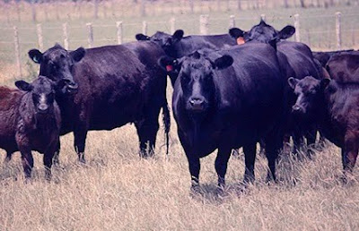
Beef Cow/Calf Enterprise Information

Slide 53
Beef Cow-Calf Returns – No Backgrounding
Net Return per Cow
Notes:
Beef excluding backgrounding. Before labor & mgt

Slide 54
Beef Cow-Calf – (excluding backgrounding)
Costs and Returns of Production per Cow
Net Returns: $98 $50 $542
w/ Lbr&Mgt: -$35 -$78 $434
Notes:
Excluding backgrounding

Slide 55
Beef Cow-Calf – (including backgrounding)
Costs and Returns of Production per Cow
Net Returns: $172 -$72 $213 $225 $268
w/ Lbr&Mgt $44 -$242 $76 $104 $172

Slide 56
Beef Cow-Calf – With Backgrounding Only
Select Factors
 | 2021 |  | 2022 |  | 2023
Factor | Avg | High 20% | Avg | High 20% | Avg | High 20%
Net Return | ($165.68) | $299.29 | ($235.79) | $182.65 | $283.12 | $820.81
Number of Cows | 61.2 | 60.3 | 67.2 | 59.4 | 81.9 | 125.7
Calving Percentage | 92.0% | 95.0% | 90.9% | 97.6% | 90.1% | 92.1%
Weaning Percentage | 86.9% | 92.4% | 83.4% | 95.5% | 82.5% | 83.8%
Cows Per FTE | 268.9 | 212.8 | 262.7 | 278.0 | 297.3 | 355.2
Average Weaning Weight | 527 | 544 | 536 | 554 | 514 | 506
Lb. Weaned/Exposed Cow | 458 | 503 | 447 | 529 | 424 | 423
Feed Cost per Cow | $549.62 | $486.66 | $640.45 | $476.05 | $620.34 | $449.29
Avg wgt/Beef Calves Sold | 572 | 622 | 545 | 611 | 635 | 592
Avg Price/CWT | $153.79 | $151.03 | $180.23 | $176.29 | $218.16 | $230.38
Notes:
The high 20% return farms consistently have a higher weaning percentage, resulting in more Lb weaned per exposed female. The high return group also has consistently lower feed costs.

Slide 57
Beef Cow-Calf –
With & Without Backgrounding per Cow
Net Returns: $98 $283

Slide 58
Beef Cow-Calf –
With & Without Backgrounding per Cow

Slide 59
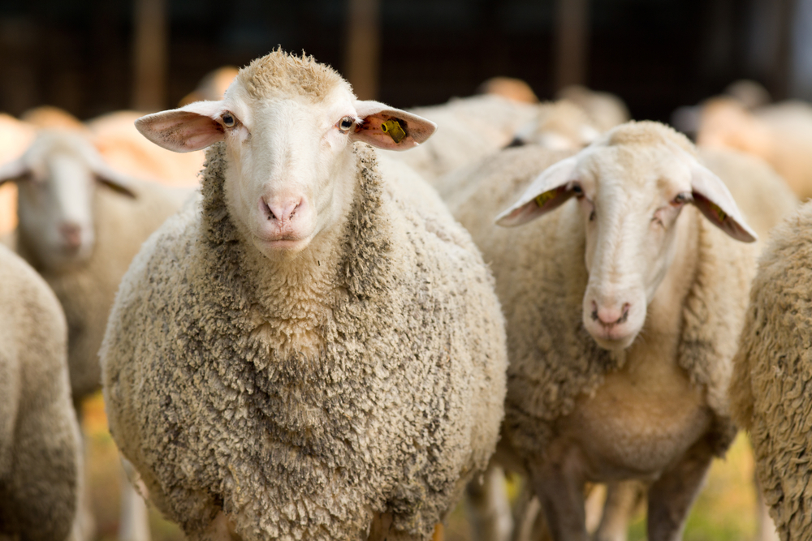
Sheep Enterprise Information

Slide 60
Sheep – Market Lamb Production
Per Ewe – year trend
Net Returns: $123 -$85 $15

Slide 61
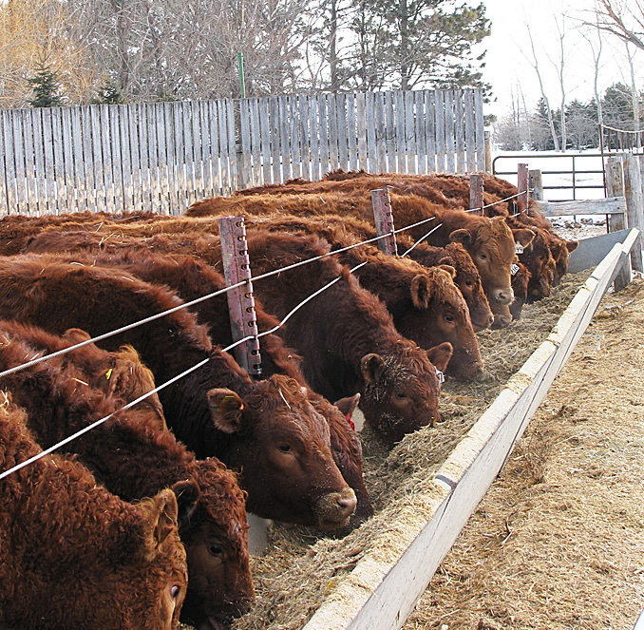
Beef & Dairy Finishing Enterprise Information

Slide 62
Dairy Finishing –
Price per Cwt up, Net Return higher
Notes:
Net Return before labor & mgt

Slide 63
Dairy Finishing –
Feed Cost per cwt of gain & Net Return per CWT
Notes:
Net Return before labor & mgt

Slide 64
Beef Finishing Returns -
Net Return per CWT

Slide 65
Beef Finishing –
Feed Cost per cwt of gain & Net Return per CWT
Notes:
Net Return before labor & mgt

Slide 66
Beef Finishing
Average Weight Sold

Slide 67
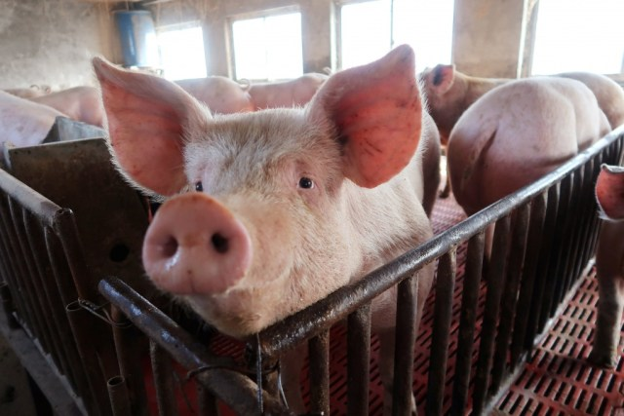
Hog Enterprise Information

Slide 68
Finish Feeder Pigs –
Net Return & Price per Cwt

Slide 69
Weaning to Finish Hogs–
Net Return & Price per Head

