Slide 1
2023 Year in Review
April 2024
Minnesota State Farm Business Management
Analysis Trend Data for2023 ________

Slide 3
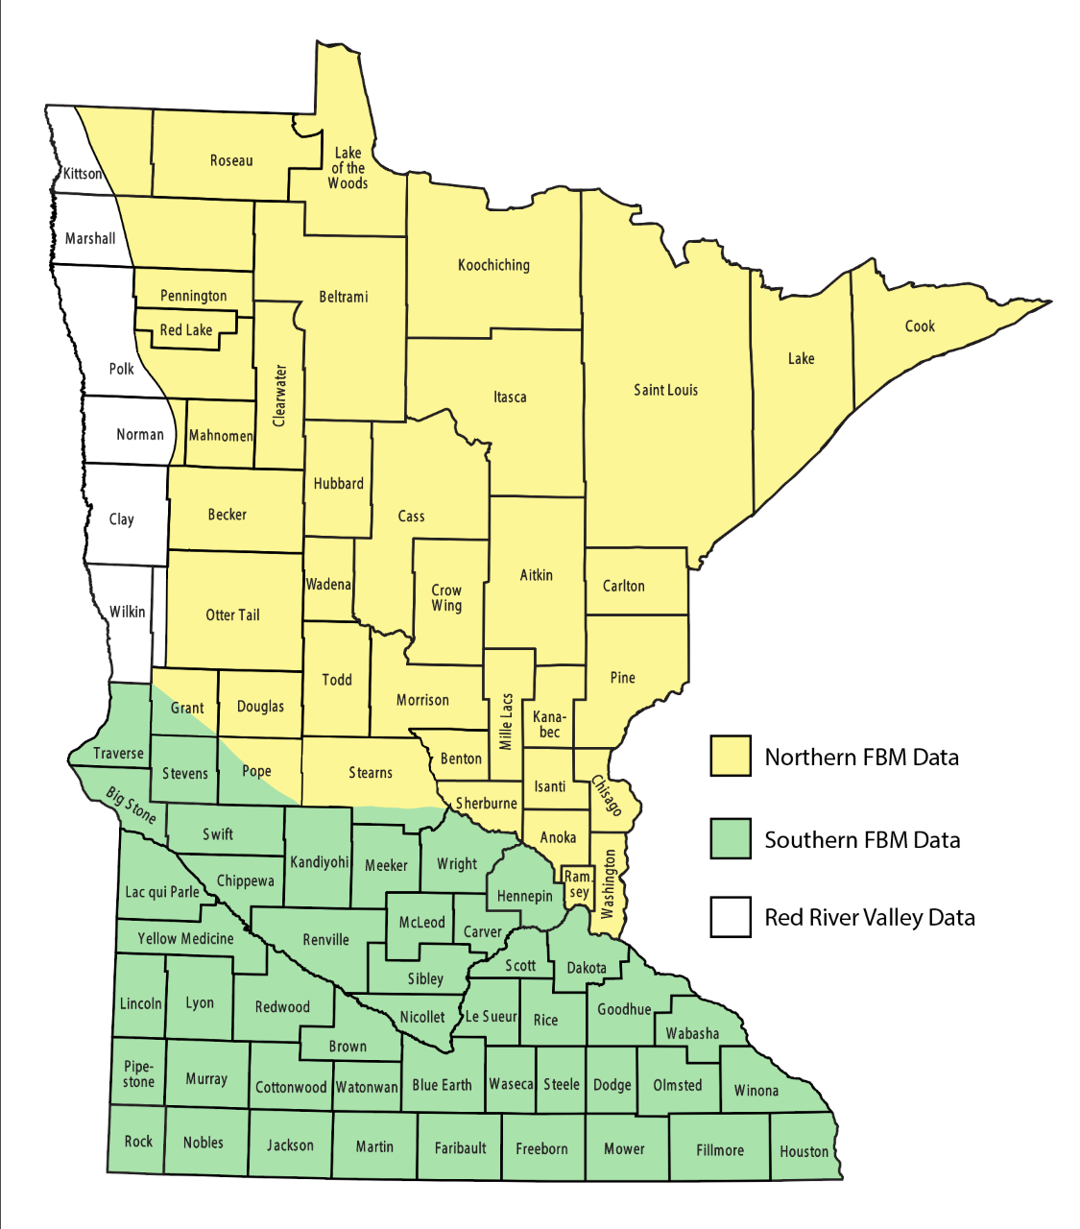
In the Report in 2023…
Cover & Inside
Northern Minnesota Report
21-year partnership between Northland and Central Lakes Colleges, and a 12-year partnership with Alexandria, and St. Cloud Colleges
Includes data from 581 farms working with 22 instructors
3

Slide 4
General Observations for
Northern Minnesota in 2023
Average Net Farm Income was $82,849 down from 2022 which was $243,910
All major crops showed a large decrease in net return compared to 2022
Livestock Returns were up in the beef cow calf and down in the dairy sector in 2023 compared to 2022 which was the opposite in 2022.
Financial Ratios were impacted negatively for a large majority of the farms in Northern MN
4

Slide 5
Farm Numbers
Pg 4

Slide 6
Differences: Region, State, and You
Pg 5
 | Year at a Glance |  |  | State |  | Your | Your
 |  |  | Northern | FBM |  | Farm | Farm
 | Data for the Average Farm |  | Minnesota | Data |  | Data | Goal
 |  | No. of Farms | 581 | 2317
 | Income Statement
 | Gross Cash Farm Income |  | $936,512 | $1,099,812 |  | _______ | _______
 | Total Cash Operating Expense |  | $798,952 | $904,500 |  | _______ | _______
 | Net Cash Farm Income |  | $137,560 | $195,312 |  | _______ | _______
 | Net Operating Profit |  | $141,383 | $155,020 |  | _______ | _______
 | Net Farm Income |  | $82,849 | $93,936 |  | _______ | _______
 | Median Farm Income |  | $40,629 | $44,596 |  | _______ | _______
 | Working Capital |  | $317,100 | $446,877 |  | _______ | _______
 | ROA |  | 3.0% | 2.8% |  | _______ | _______
 | ROE |  | 1.7% | 1.7% |  | _______ | _______
 | Oper Exp Ratio |  | 80.5% | 81.3% |  | _______ | _______

Slide 7
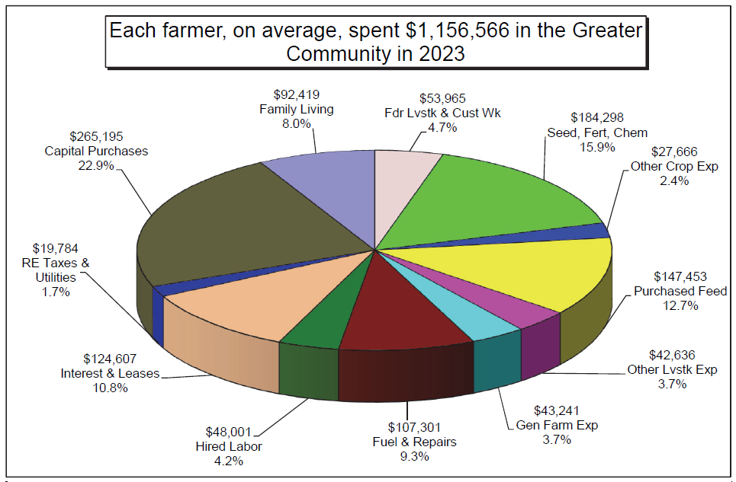
In 2023, on average…
Pg 8
572 farms = $396,679,712
A 40 yr career = $27,739,840

Slide 8
Cash Farm Income
Pg 12

Slide 9
Cash Farm Expenses
Pg 13

Slide 10
What are some income/expense changes for the average?
 | 2021 | 2022 | 2022 | 2023
Crop Income | 335,038 | 335,038 | 430,781 | 410,917
Milk Sales | 241,757 | 241,757 | 319,822 | 260,084
Seed | 47,192 | 47,192 | 54,279 | 51,789
Fertilizer | 80,274 | 80,274 | 110,652 | 93,245
Feed | 120,287 | 120,287 | 155,110 | 147,453
Fuel & Oil | 27,157 | 27,157 | 43,283 | 37,831
Repairs | 57,401 | 57,401 | 68,360 | 69,470
Hired Labor | 43,833 | 43,833 | 46,556 | 48,001
Land Rent | 60,813 | 60,813 | 70,876 | 70,625
Pg 12
Pg 13

Slide 11
Net Farm and Median Farm Income
Pg 5

Slide 12
Net Farm Income Sorted by Years Farming
Pg 9

Slide 13
Net Farm and Median Farm Income Range by Type of Farm
Pg 6

Slide 14
Family Living / Personal Spending
Pg 24

Slide 15
Net Worth Change Sorted by Farm Type (Market)
Pg 6

Slide 16
Net Worth Change Sorted by Years Farming (Market)
Pg 9

Slide 17
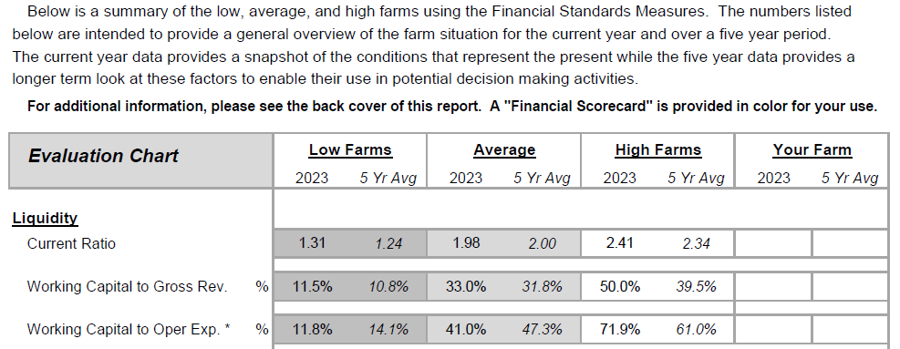
How Does Your Farm Stack UP?
Pg 21

Slide 18
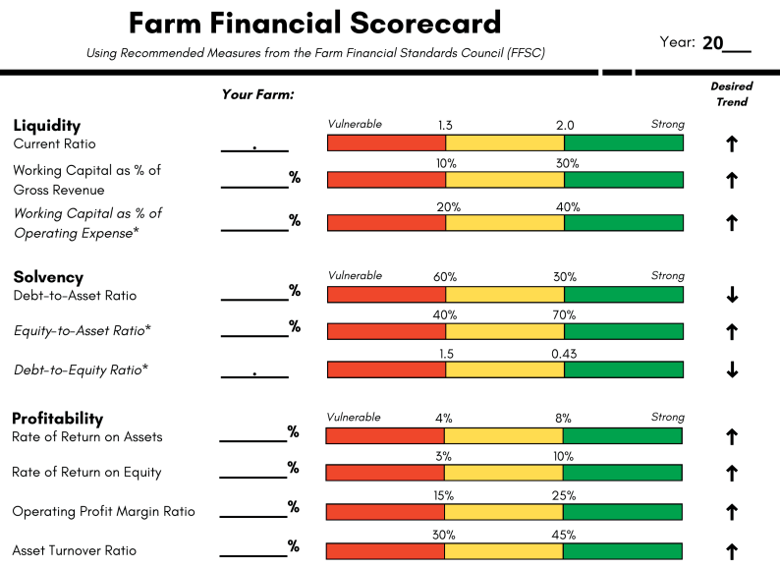
Your financial scorecard
Back Cover

Slide 19
Liquidity Measures
Pg 21

Slide 20
Liquidity Measures
Pg 21-22
Working Capital Current farm assets minus current farm liabilities
Funds available to buy inputs & inventory after the sale of current assets and payment of current liabilities
It is a dollar value, not a ratio
Working Capital as % of gross revenue
Working Capital / Gross Farm Income
Percentage that serves as an indicator of the funds available based on business size.
Working Capital as % of operating expenses
Working Capital / Operating Expenses
Percentage that serves as an indicator of the funds available based on business operating expenses.

Slide 21
Liquidity Measures
Pg 22

Slide 22
Liquidity Measures
Pg 6

Slide 23
Liquidity Measures
Pg 6

Slide 24
Solvency
Pg 21

Slide 25
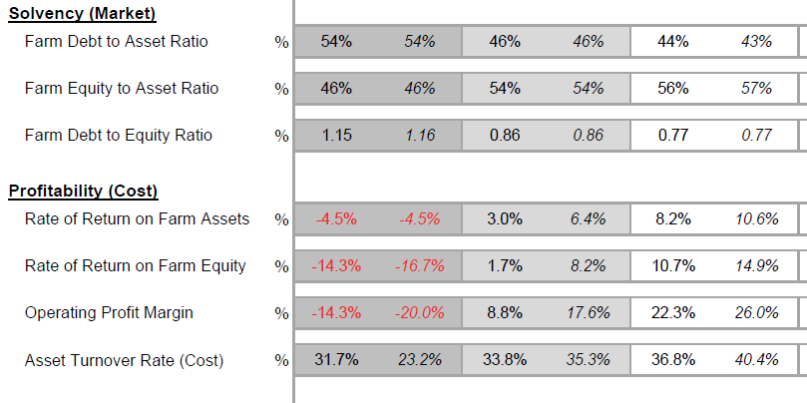
How Does Your Farm Stack UP?
Pg 21
`

Slide 26
Profitability
Rate of Return on Assets
Interest rate earned on all money invested in the business…
Rate of Return on Equity
Interest rate earned on YOUR money invested in the business…

Slide 27
Your financial scorecard
Back Cover

Slide 28
Profitability
Pg 21

Slide 29
Profitability
Pg 6

Slide 30
How Does Your Farm Stack UP?
Pg 21

Slide 31
Repayment Capacity
*Debt Coverage Ratio-New Ratio in 2022
The Debt Coverage Ratio measures the ability of the business to pay all current, intermediate and long-term debt payments.
Term Debt Coverage Ratio
The Term Debt Coverage Ratio measures the ability of the business to pay all intermediate and long-term debt payments.

Slide 32
Repayment Capacity
Pg 21

Slide 33
Repayment Capacity
Pg 6

Slide 34
Repayment Capacity
Pg 21

Slide 35
Repayment Capacity
Pg 6

Slide 36
How Does Your Farm Stack UP?
Pg 21

Slide 37
Your financial scorecard
Back Cover

Slide 38
Efficiency Measures
Operating Expense Ratio
One of four Efficiency Measures found on the list of key Financial Standard Measures. This ratio shows the percent of Gross Farm Income that is used to pay for operating expense, excluding interest.
The other 3 ratios are: interest expense, depreciation expense, and net farm income.

Slide 39
Efficiency Measures

Slide 40
Special Reports
We have three 8-page special reports that are developed to share targeted data from the Minnesota State Database:
State Executive Summary
State Crop Sort
State Dairy Sort

Slide 41
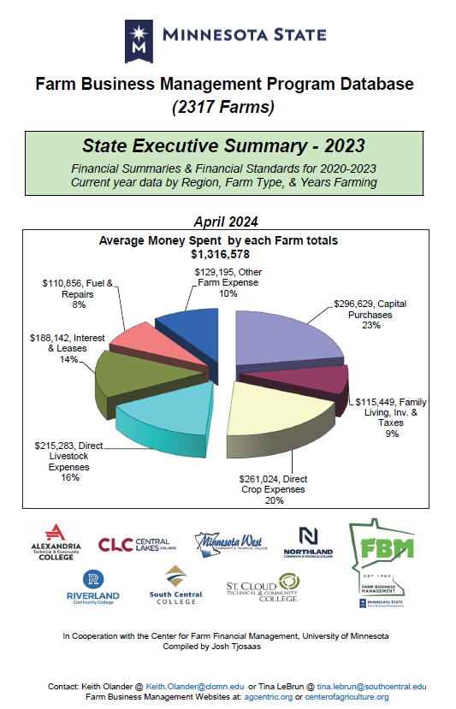
Special Reports

Slide 42
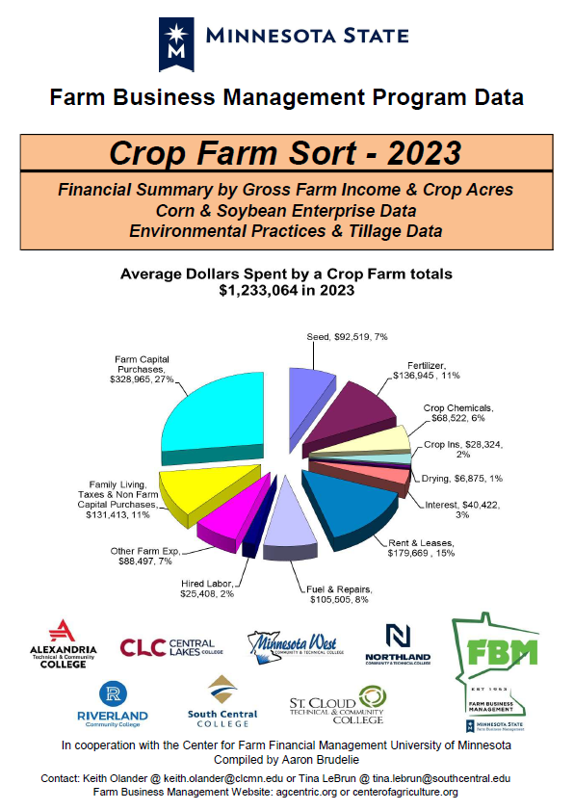
Special Reports

Slide 43
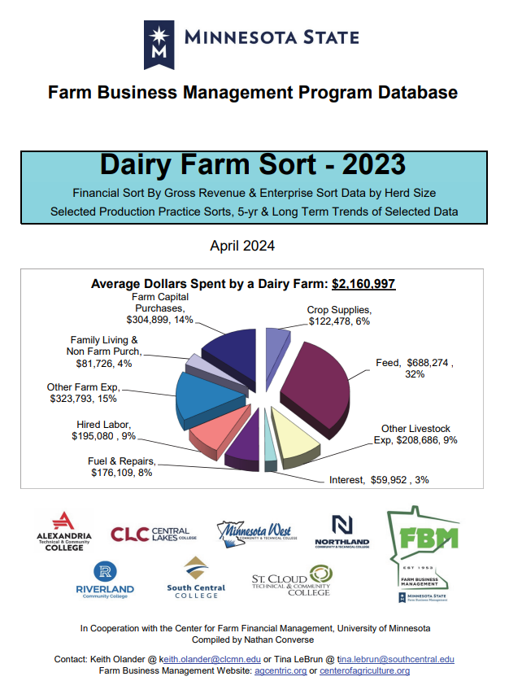
Special Reports

Slide 44
For more information….

Slide 45
Break for the next presenter…

